Slide 1
The management of contaminated sites in Switzerland
Division Soil and Biotecnology
1.6.2017
Notes:
Hello everybody.
Thank you Mr. Brangulis for having invitated me to talk to you about the situation in Switzerland.
My name is Reto Tietz, im geologist and since 8 years im the deputy head of the contaminated sites section, in the federal office for the environnement.

Slide 2

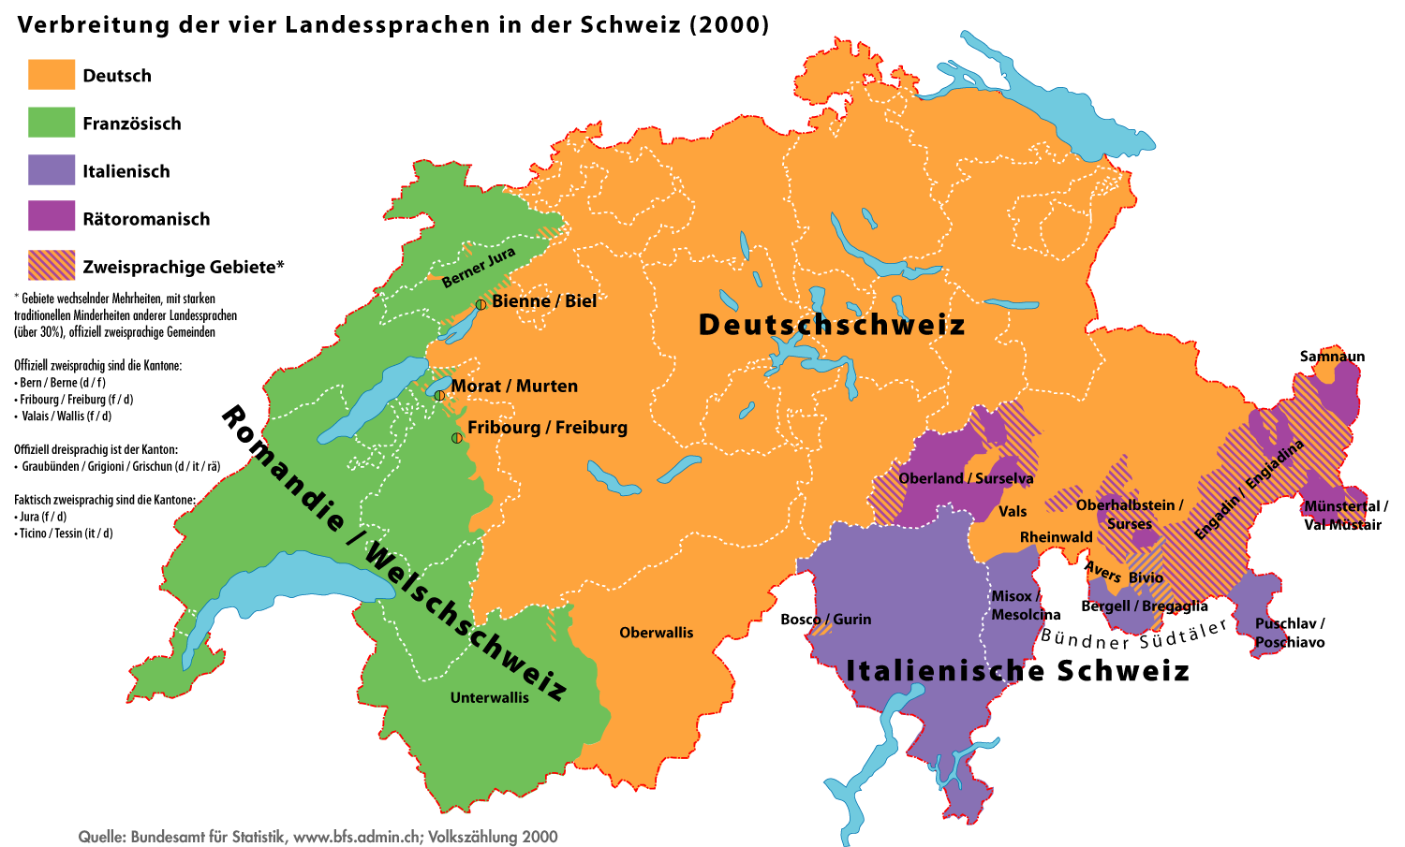




Switzerland
220 km
350 km
Notes:
Let me first of all say some words about Switzerland.
Like Latvia Switzerland is a small country.
You see here the dimensions.
We have a population of 8.5 Mio. habitants
and 4 officially languages, swiss german, french, italian and romantsch a language spoken only in CH.
As you may hear english is not our language.

Slide 3
Agenda
Legislation concerning the „contaminated sites“
Register of polluted sites
Financing of the measures
Remediation of a hazardous landfill
Notes:
In the next 25 Minutes I want talk to you about these topics:
As wished by Mr. Brangulis I will tell you something about our legislation,
I will show you our register of polluted sites
How do we finance the treatment of our sites
Finally the remediation of our in term of costs far biggest contaminated site called SMDK or Kölliken.

Slide 4
1. Legislation concerning the contaminated sites
Federal Act on the Protection of the Environment (Environmental Protection Act, EPA)
Ordinance on the Remediation of Polluted Sites (Contaminated Sites Ordinance, CSO) 1998
Ordinance on the Charge for the Remediation of Contaminated Sites (OCRCS) since 2001
Notes:
You can find our legislation (the english versions to) on the internet.
Since 1985 we have a federal act on the protection of the environment. Since 1997 in this act we have some articles concerning the contaminated sites.
One year later, we published the Contaminated sites Ordinance, an ordinance that regulates most of our tasks.
In 2001, with the “Ordinance on the Charge for the remediation” we have regulated also the financing of the measures (we will talk about this topic later).

Slide 5
1. Structure of the CSO (AltlV)
Section 1 (art. 1 through 4) establishes the purpose and scope of the ordinance and defines important terminology.
Section 2 (art. 5 and 6) specifies how sites polluted by wastes are to be registered in a publically accessible register and how this register is to be maintained.
Section 3 (art. 7 - 13) specifies how a polluted site is to be assessed and classified by means of a preliminary investigation of its need for remediation or monitoring.
Section 4 (art. 14 and 15) defines the objectives and urgency of a remediation on the basis of a risk assessment made after a detailed investigation.
Section 5 (art. 16 - 19) establishes how remediation projects are to be drawn up and the criteria used by the authorities to approve the remediation measures; the assessment of results and the duty to report are also specified.
Section 6 (art. 20) specifies who the authorities may require to carry out investigations, monitoring and remediation measures.
Section 7 (art. 21 - 28) covers the final provisions.
Annexes: contain values for assessing the impacts on water and air and the requisite procedures for carrying out such assessments.
Notes:
You see here the structure of the contaminated sites ordinance (CSO):
There is defined the purpose and scope of the ordinance,
and the public register of polluted sites (we will talk about this just later),
As main part in section 3 there are the criteria that define the assessment and classification of polluted sites.
For the sites needing a remediation we have of course the objectives and urgency of remediations,
and how remediation projects have to be drawn up.
and finally who has to carry out the measures.

Slide 6
1. Definitions
Polluted sites are operative or inoperative waste disposal sites (landfills) and industrial and accident sites in which waste was deposited or infiltrated.
Contaminated sites are polluted sites that cause harmful effects or nuisances or for which there is a real danger that such effects may arise. Such sites require remediation!
Notes:
Like most countries of Europe - we distinguish polluted sites from contaminated sites:
contaminated sites do request a remediation
only polluted sites, need nothing or at most a monitoring.

Slide 7
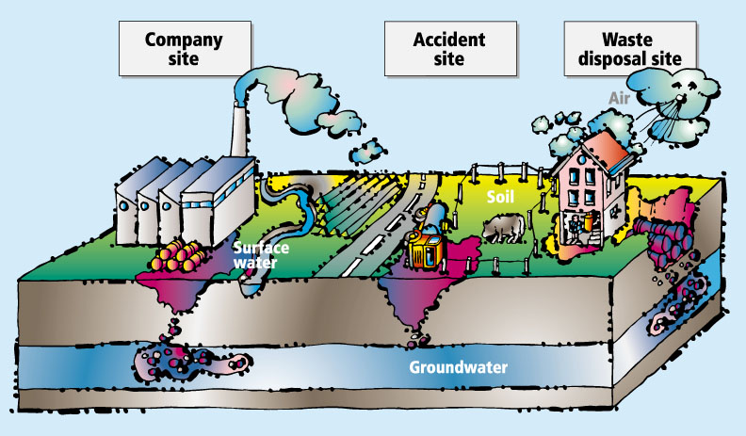
1. Types of polluted sites
Notes:
On this slide you see the different types of polluted sites:
disposal sites (old landfills), company sites (such as industrial areas) and accident sites (there are not a lot of them).
On this image you see also the natural resources that are considered in the assessment of polluted sites:
the groundwater, the surface water, the soil and the air.

Slide 8
1. The five objectives
rapid remediation of severe contaminated sites
stepwise management of polluted sites
solution to the contaminated sites problem within 2 generations
stop emissions at source
long term, sustainable elimination of hazard
Notes:
These are the six objectives that are leading our doing:
- We want a rapid remediation of highly contaminated sites (such as SMDK)
- a stepwise procedure (as we will see in the next slide)
- the solution of the problem has to be done until 2040
- in case of remediation to stop the emissions at the source and that the remediations must be definitive

Slide 9
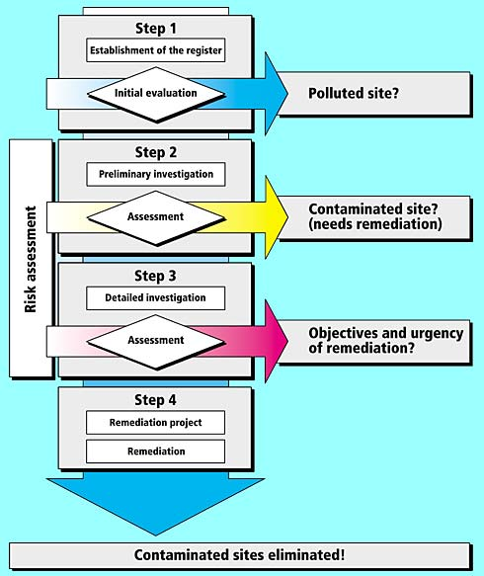
1. The approach
Notes:
In CH we have 26 regions (we call them cantons). The environmental offices of these regions are the leading authorities in the management of the polluted sites.
The procedure in CH is divided in to 4 steps.
In the first step the authorities have to establish a public register, therefore the cantons have to do a first evaluation and estimate which sites are polluted.
After this - they have to order a preliminary investigation if one is necessary (only one third of all polluted sites do need an investigation).
If the risk assessment shows that there is a need of remediation, the authority order a detailed investigation and define based on this the objectives and urgency of the remediation.
In the last step the owner of the site has to establish a remediation project an to do the remediation.

Slide 10
1. The preliminary investigation
Objectives:
To investigate the impact on the natural resources:
groundwater
surface water
soil
air
Based on the results of the preliminary investigation the authority decides on:
pollution without hazard for the environment
the need for monitoring
the need to remediate = contaminated site
Notes:
Let me say some words about the preliminary investigation.
The goal is to define the impact of a site on the natural resources.
That is one of the most important steps, that defines if a site has to be monitored, remediated or none of them.

Slide 11
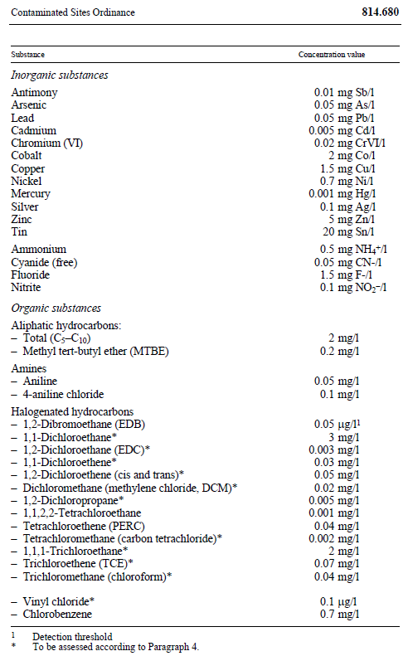
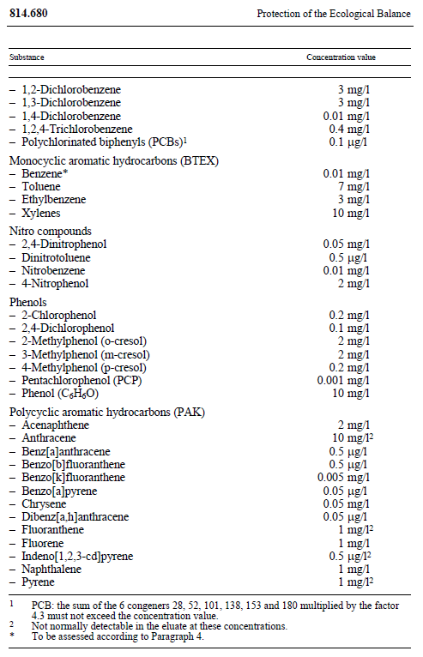
1. Concentration values for groundwater
Notes:
For the assessment of the sites
the appendix of the “Contaminated sites ordinance” defines some concentrations values for all the natural resources mentioned before.
Here, for instance, you see the concentrations values for groundwater.

Slide 12
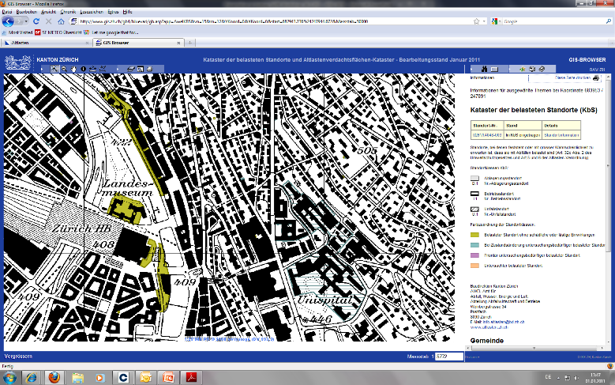
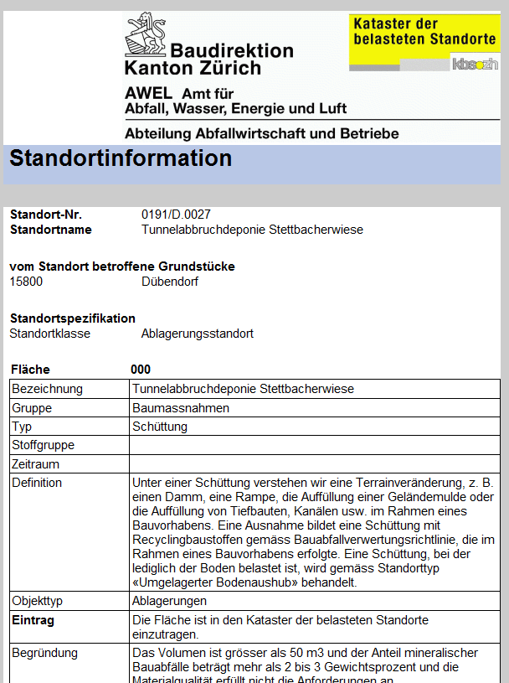
2. Basics - Register of polluted sites
Zurich:
Notes:
Every canton has a register of the polluted sites.
On this slide you see part of the public register of the canton Zürich. The green areas are the polluted sites near the railstation of Zurich.
Everybody via internet has access to all information an even to the statue of every site.

Slide 13
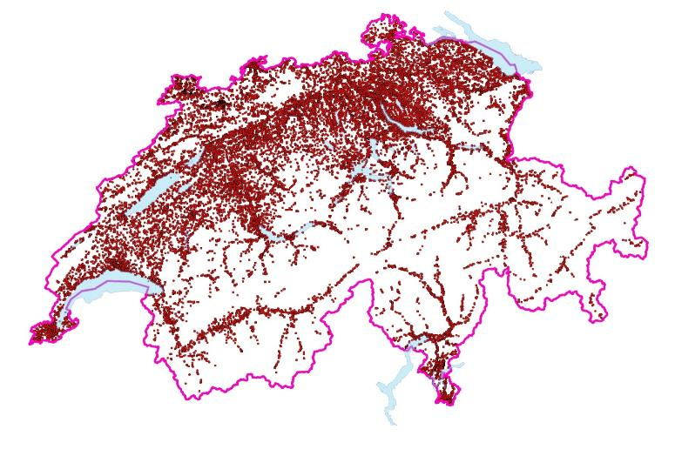
2. Statistics of the pollutes sites
Geographical distribution
Total: ~38‘000 polluted sites
Notes:
Totally in CH we have 38‘000 polluted sites
and we expect to have around 4‘000 contaminated sites, that need a remediation.

Slide 14
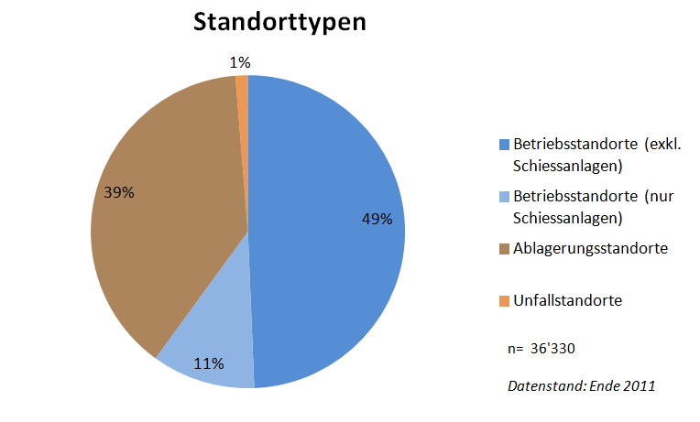
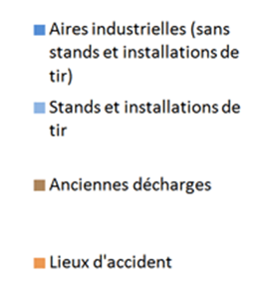
2. Statistics of the pollutes sites
Categories of the polluted sites
Total: ~38‘000 sites
Industrial sites
Shooting ranges
Waste disposal sites
Accident sites
Notes:
Here you see the distribution of the different types of sites.
Half of them are industrial sites,
we have about 4‘000 shooting ranges,
and about 15‘000 old landfills,
and fortunately only a few accident sites

Slide 15
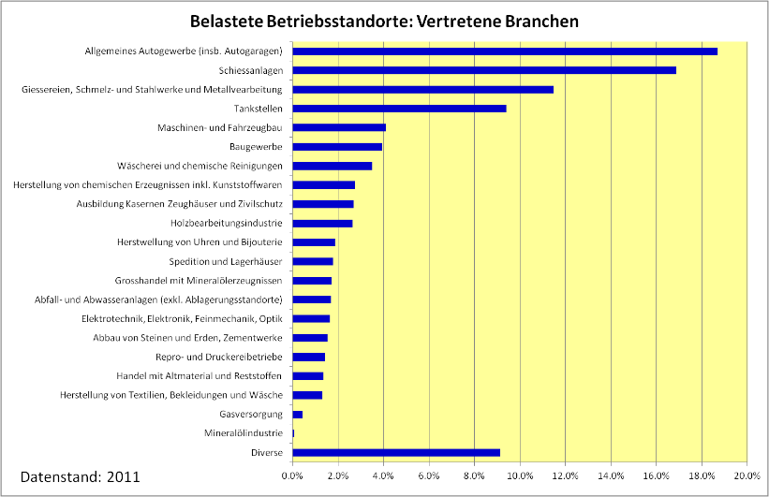
2. Statistics of the pollutes sites
Industrial sites: sectors
Automobile workshops
Shooting ranges
Foundries, steel works, metal working
Service stations
Notes:
The most important sectors of the polluted industrial sites in CH are ...

Slide 16
registered site
are harmful effects
possible ?
no
site without hazard for the environment
yes
site requesting a investigation
preliminary investigation
site requesting neither a monitoring nor a remediation
assessment of the site
site requesting a monitoring
monitoring
site requesting a remediation (contaminated)
remediation
Notes:
This is once again the assessment procedure:
Once in the registry the authority has to define if the site has to be investigated or not.
Based on the investigation results there are 3 possible classifications or statues:
- site requesting a monitoring
site requesting a remediation
and those who needs neither of them
Please remember the colors for the next slide

Slide 17
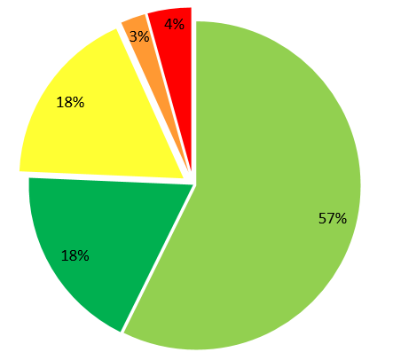
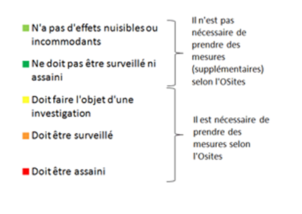
2. Statistics of the pollutes sites
The status of the polluted sites corresponding to the CSO
No harmful effect or nuisances are to be expected
In need of neither monitoring nor remediation
Requiring an investigation
In need of monitoring
In need of remediation
Notes:
This diagramm, shows you the actual statue of the sites in CH:
So in short:
The green ones are OK, and for the others there is something to do.
The Yellow-ones: still need at least a preliminary investigation
Orange-ones: a monitoring
Red-ones: a remediation
Out of the investigations there will result other sites to monitor or to remediate

Slide 18
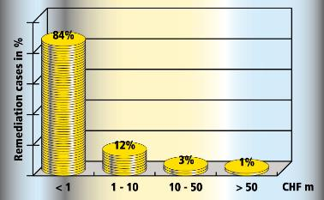
3 Costs
register
preliminary
investigation
detailed
investigation
38’000
polluted sites
x Fr. 1’000.-
~ Fr. 38 Mio.
13’000
Investigations
x Fr. 30’000.-
~ Fr. 400 Mio.
3’700
detailed
investigation
x Fr. 150’000.-
~ Fr. 550 Mio.
remediation
4’000
remediations
x Fr. 1 Mio.
~ Fr. 4’000 Mio.
= Fr. 5 billions
Notes:
We expect, that the overall costs including all the measures are about 5 billions of swiss francs (this is something about 4.5 billions of euros).
The biggest part of it is generated by remediations.
Most remediations will cost less than a million and only very few will cost more than 50 Mio.
SMDK is, with almost 1 billion of francs the far most expensive remediation in Switzerland.

Slide 19
3. Responsabilities
Who has to take action (investigations, monitoring, remediation, aftercare)?
To take and performe the measures is fundamentally the concern of the owner of the site
Who has to pay the measures?
The polluter is the party who caused the pollution of the site through his/her actions or through the actions of a third party acting on his/her behalf.
The owner is the party exercising legal or actual control over the polluted site which contravenes the regulations. In the contaminated site sector, this is the owner (actual owner, leaseholder, tenant, agent) of the site.
Notes:
All the measures have to be done by the owner of a contaminated site.
If there are more responsibles, the costs are shared, based on a decision made by the environmental authority.
Generally 70 to 90% of the costs are paid by the polluter and 10 to 30% by the owner.

Slide 20
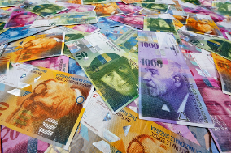
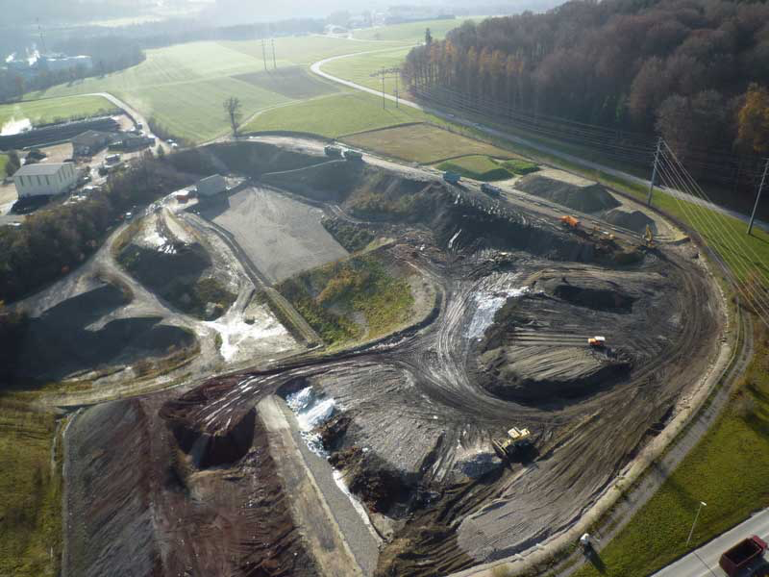
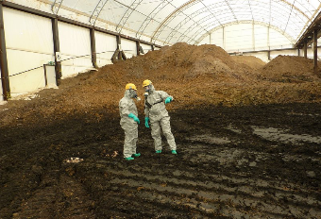
3. Subsidy by the Ordinance OCRCS (VASA)
40 Mio. CHF / Year
Notes:
As mentioned before, since 2001 we have a fund (called VASA), that helps the regions to cover their costs, when the responsibles doesn‘t exist anymore.
This found is fed by a tax raised on every ton of waste that goes in a landfill.
Every year we have an income of about 40 Mio. of Fr. that is spent for investigations and remediations.

Slide 21
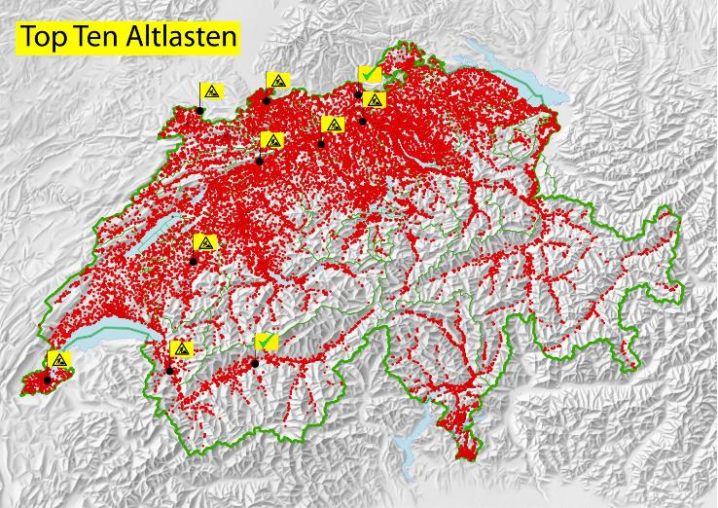
4. Main contaminated sites
Well known contaminated sites in Switzerland:
Muttenz
„Bärengraben“
Bonfol
ABB Baden
„Stadtmist“
Kölliken
La Pila
Hg-Grossgrundkanal
Usine à gaz de genève
Pramont
Monthey
Notes:
These are our major contaminated sites :
The green ones are already remediated,
by the yellow ones work is still in progress
Let’s move to the landfill of Kölliken

Slide 22
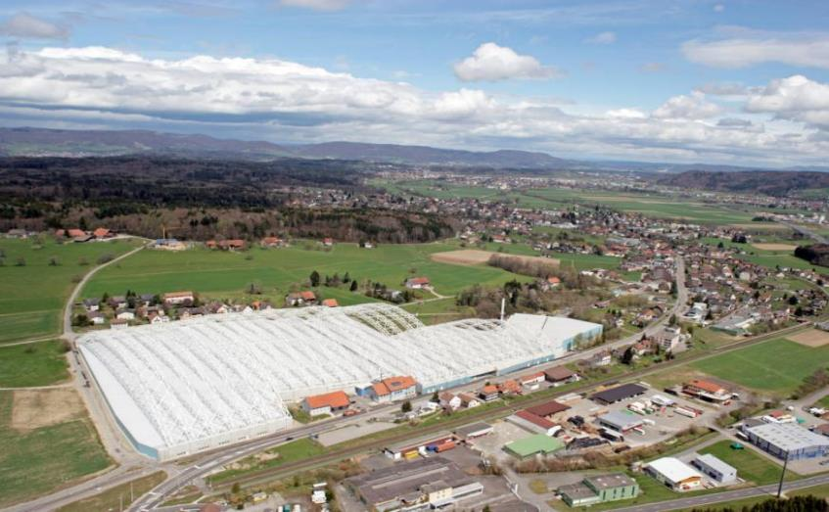
4. Remediation of SMDK
Notes:
I have to thank the Consortium SMDK, that carried out the remediation for most of the following slides.
What you see here is the big hall with the white arches near the town of Kölliken.

Slide 23
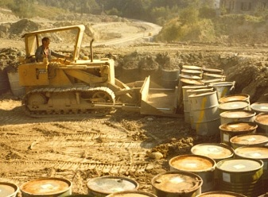
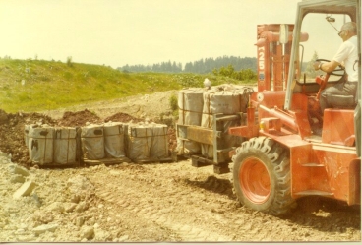
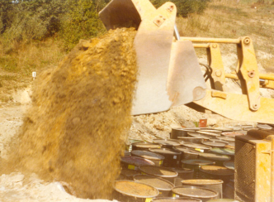
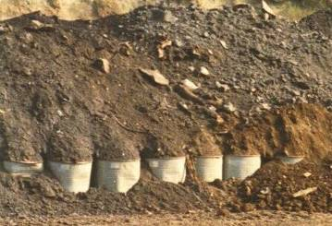
4. Historic pictures of the disposal
1978 - 1985
Notes:
That‘s what it looked about 40 years ago.
An old clay pit was filled up with hazardous waste from the pharmaceutical and chemical industry.

Slide 24
4. Waste types 1978-1985
343‘000 t excav. material and
incineration slag
28‘000 t Big-bags
65‘000 t Barrels
21‘000 t Various waste
457‘000 t
Notes:
What you see here are the different waste types, that were stocked in the landfill.
The main problem for the environment came evidently from the big-bags an the barrels filled with chemical waste.

Slide 25

4. Emission of pollutants
Groundwater-filled gravel-channel
landfill
marl
sandstone
sandstone
marl
Notes:
The problem was that the underground of the old clay pit, is not only clay but a sequence of marl and sandstone.
The percolation water of the landfill flowed trough these sandstone-layers to the main gravel aquifer.

Slide 26
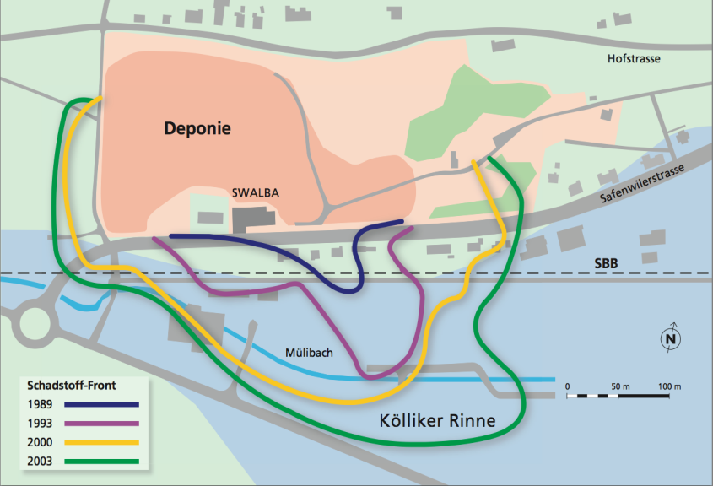
4. Emission of pollutants
landfill
Pollutant frontline
Notes:
The subsequent monitoring of the landfill showed that the pollutants were progressively spreading in the groundwater.

Slide 27
4. Containment or decontamination
Comparison of the cumulated costs
decontamination
containment
costs
100 – 150 years
time
Notes:
An evaluation of different remediation technologies was made at the end of the last century.
This showed, that a containment would have to be maintained for very long time,
and over 100 to 150 years it would be more expensive than a short termed decontamination.
Proverb: It’s better to make a painful break, than to draw out the agony.

Slide 28
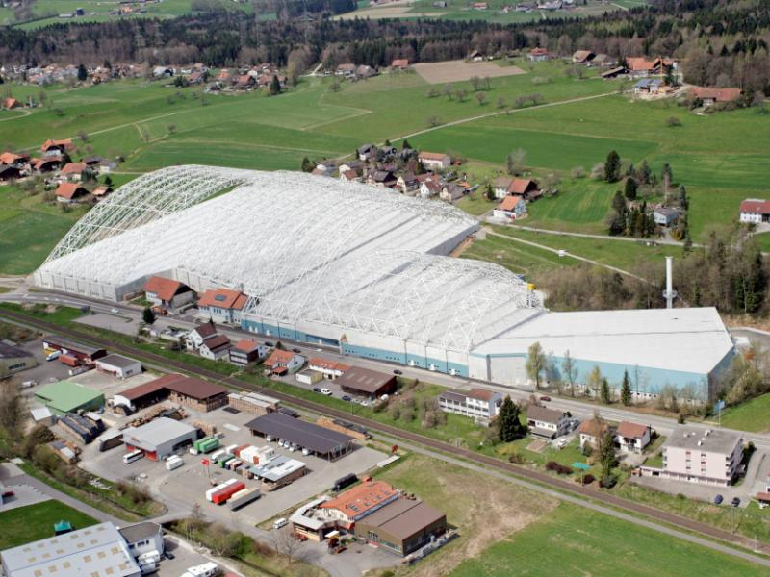
4. Infrastructure
170 m
33´000 m²
8´000 m²
5´000 m²
Notes:
To contain the dust- and the smell first of all the consortium installed a big hall.
This hall was put under a negative pressure and a sophisticated filter plant cleaned the air.
You see here the huge dimension of this pillarless hall.

Slide 29
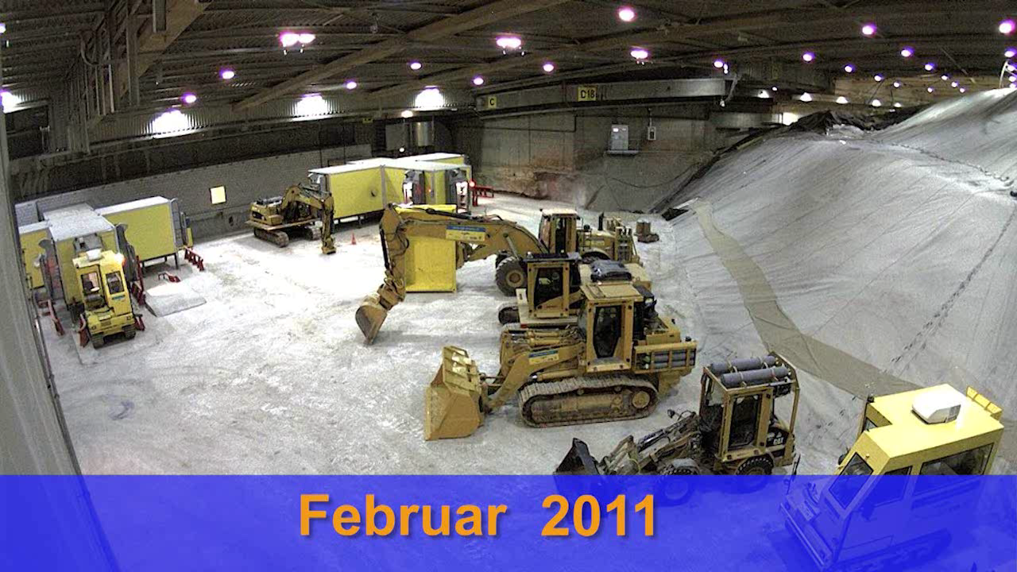
4. Hermetic excavators and docking stations
Notes:
These are the hermetic excavators and docking stations needed to protect the working staff.
Nobody worked by foot in the hall, everything was done with these machines.
You can see also the air-bottles on the machines.

Slide 30
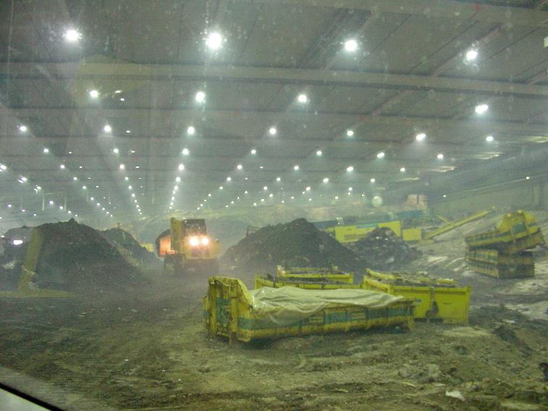
4. Remediation
Notes:
That‘s a view inside the hall from work in progress.

Slide 31
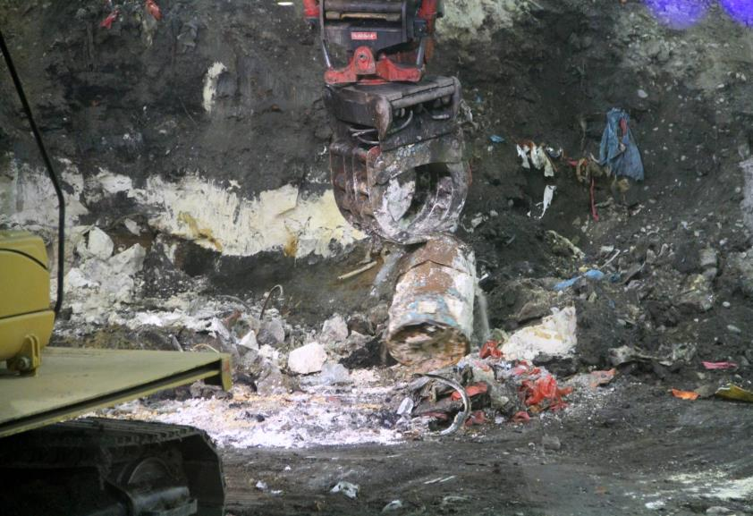
4. Recovering the barrels
Notes:
Every barrel was recovered one by one and analyzed by over 100 parameters.

Slide 32
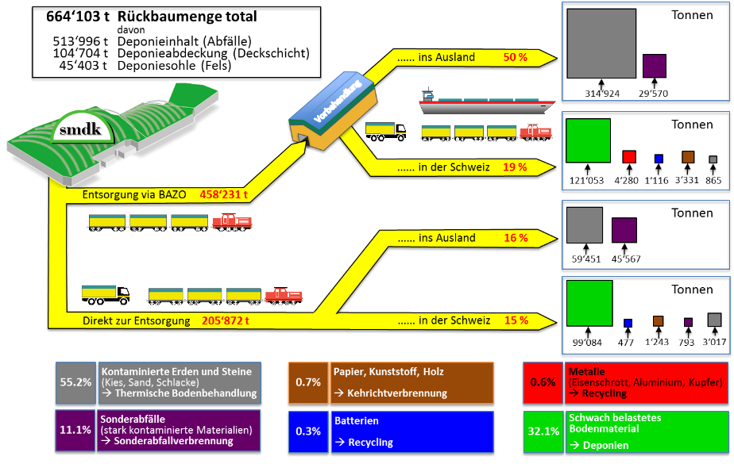
4. Disposal ways
Total quantity
hereof:
Waste
Cover material
Landfill basement (rock)
Tons
…… abroad
Pretreatment
Tons
…… in Switzerland
Disposed via BAZO
Tons
…… abroad
Tons
Directly disposed
…… in Switzerland
Contaminated soil an rock
(slags, sand, gravel)
➔ Thermal soil treatment
Paper, Plastics, Wood
➔ Incineration
Metals
(Iron scrap), Aluminum, Copper)
Hazardous waste
Heavy contaminated Materials
➔ Incin. plant for haz. waste
Batteries
Weakly contaminated
Excavation material
➔ Landfill
Notes:
What was finally done with the excavated waste?
To reduce the disposal costs a lot of waste had to be pretreated (by magnets and sieves).
The weakly polluted excavation material, was deposited in swiss landfills.
Strongly chemical polluted waste was mainly exported in a thermal treatment-plant for soil (600C) or in incineration plants for hazardous waste (1‘100C).
Most of the material was transported by train or ship.

Slide 33
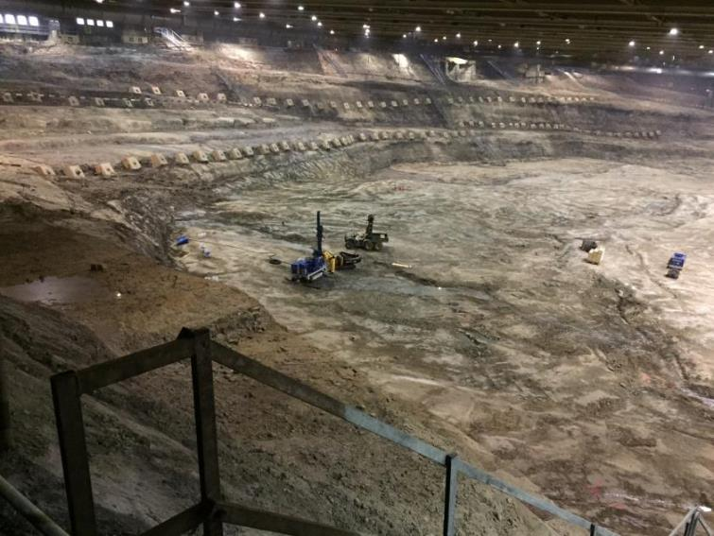
July 13. 2015,
End of the waste excavation
Notes:
In summer 2015 the last shovel of waste was removed. You see here the empty pit.
After that even the contaminated rock had to be removed for a depth of some dm to m.
At the moment the consortium is filling up the pit with clean excavation material from a tunnel project.

Slide 34
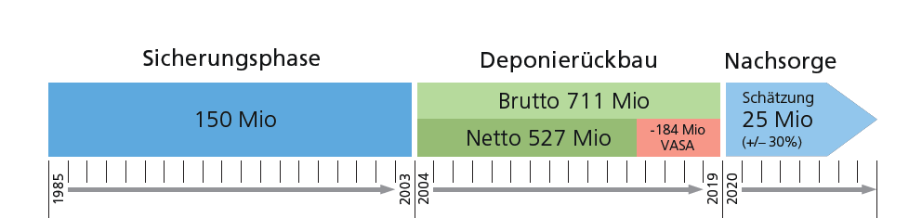
4. Costs
Investigation and securisation
Decontamination
Aftercare
Total remediation costs 886 Mio. CHF
Notes:
Over the time only on this remediation more than 800 Million Euros were spent.
It’s clear most of them was spent in the last 15 years on the decontamination of the site.

Slide 35

Questions?
Notes:
Let me close up with this image:
That’s not a contaminated site!
That’s Buzz Aldrin the 2. man on the moon on a advertising spot for tourism in Switzerland.
Beside the 38’000 polluted sites, Switzerland is still a very nice country, worth to visit.
If there are some questions, I will try to answer them.
Thanks

Slide 37

Questions?
Notes:
Voilà that’s it.
I propose to start the discussion.
It would be interesting to us to know from you how is your practices.

Slide 38
Tasks of the involved parties
The party responsible for the investigations and remediation must:
carry out the investigations: preliminary investigation and detailed investigation in case of a contaminated site
work out the remediation project to be submitted to the authorities, proposing the optimal remediation approach and the definitive objectives of remediation.
complete the remediation and monitor it if necessary, produce documentation on it and report the successful termination of all measures.
The cantonal environmental authorities must:
assess the remediation measures proposed by the remediation project, establish the final remediation objectives, deadlines and any other documentation and conditions.
rule on cost sharing in the case of several polluters.
issue an opinion on the success of the implemented remediation measures and the remediation report after its completion.
Notes:
There are mainly two players in dealing with polluted sites:
the owner of the site has to carry out the investigations, the monitoring and in case of contaminated sites the remediations.
the cantonal autority has to order, to survey and to assess all these measures. In case of several polluters the autority has to make a cost sharing decision.

Slide 39
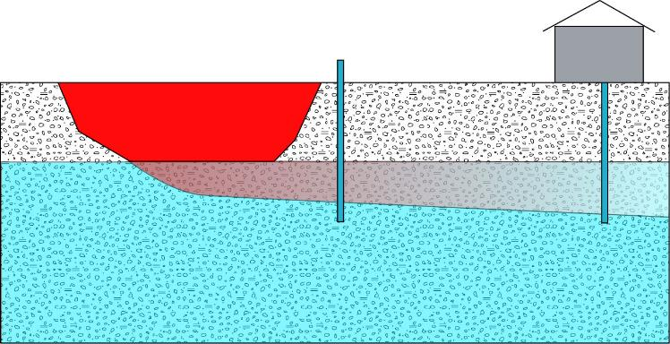
When do a site requests a remediation in case of groundwater?
groundwater well
→ detection of pollutants
immediately downstream
> concentration values
(drinkable water)
Notes:
These values are very strict:
For example if you have a site located in good an exploitable groundwater, there is a need for remediation if immediately downstream the concentration of pollutants exeeds the half of the concentration value (of the list shown before).
These concentrations values are equal to the quality values for drinkable water.
So the goal is to have drinkable water outside all polluted sites!
If downstream there is a groundwater well of public interest, you will have already the need of remediation if some pollutants are detected in the drinking water.
So you see, our legislation is very strictly.

Slide 40
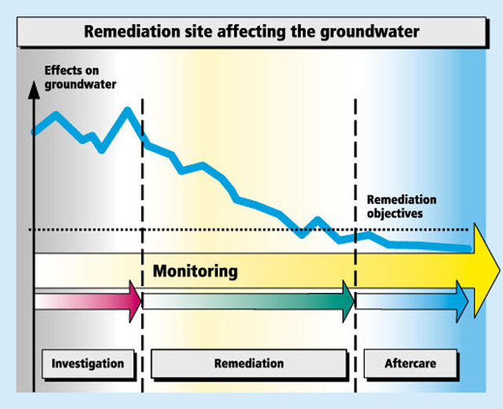
Remediation objectives
Notes:
Here everything graphically.
If the owner by the preliminary investigation has pollutants exceeding the concentration values, there is a need for remediation.
The remediation measures have to reduce the concentrations in the groundwater under the concentrations values.

Slide 41
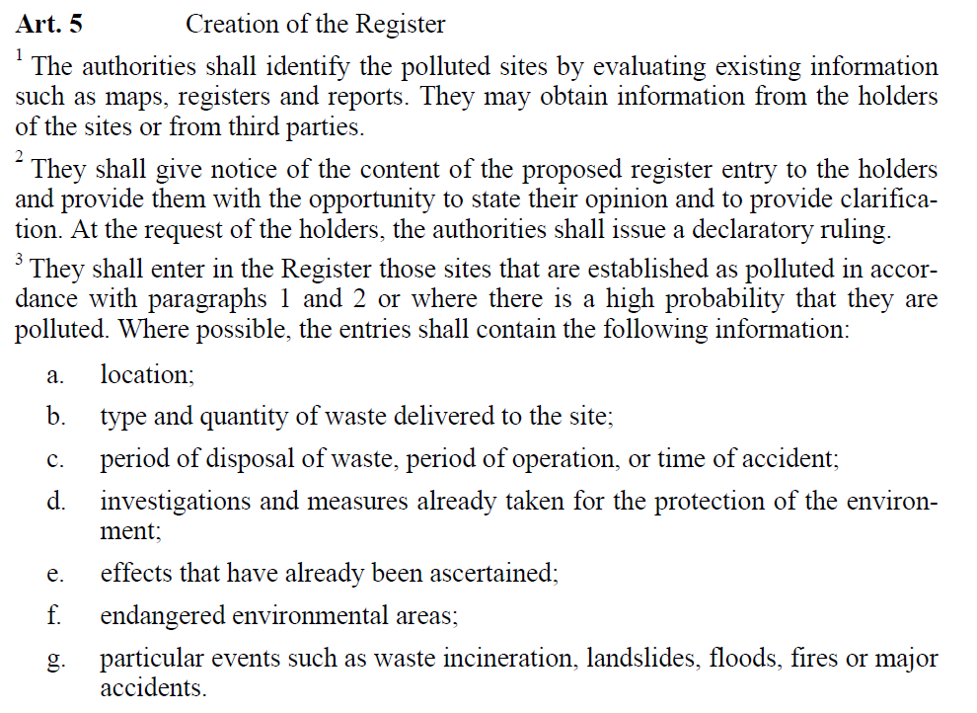
1. Basics - Register of polluted sites
Notes:
Art. 5 of the CSO specifies the register of polluted sites:
In particular that the authorities shall identify the polluted sites and shall enter them in the ROPS, if there is a high probability that they are polluted.
Furthermore it is defined which information the entries shall contain:
In particular:

Slide 42
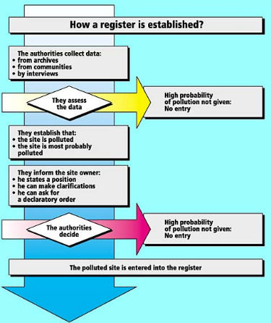
1. Basics - Register of polluted sites
Notes:
Here you can see how the register is established in a skiiim (schema):

Slide 43
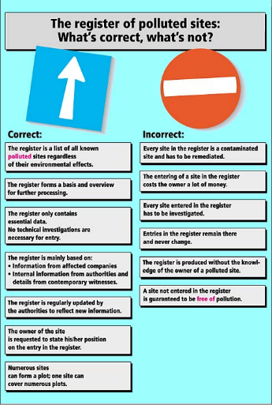
1. Basics - Register of polluted sites
Notes:
In this skiim on the right side:
you can see some prejudicies or missunderstandings about the Register (predschedissis)
Especially in the beginning people were afraid that:
Every site in the register had to be remediated
Or that entries in the register remain there and never change
Nowadays most peple know that this isnt true:
The register ist a list of all known polluted sites…
and
The register ist dynamic and the entries are regularly updated by the authorities

Slide 44
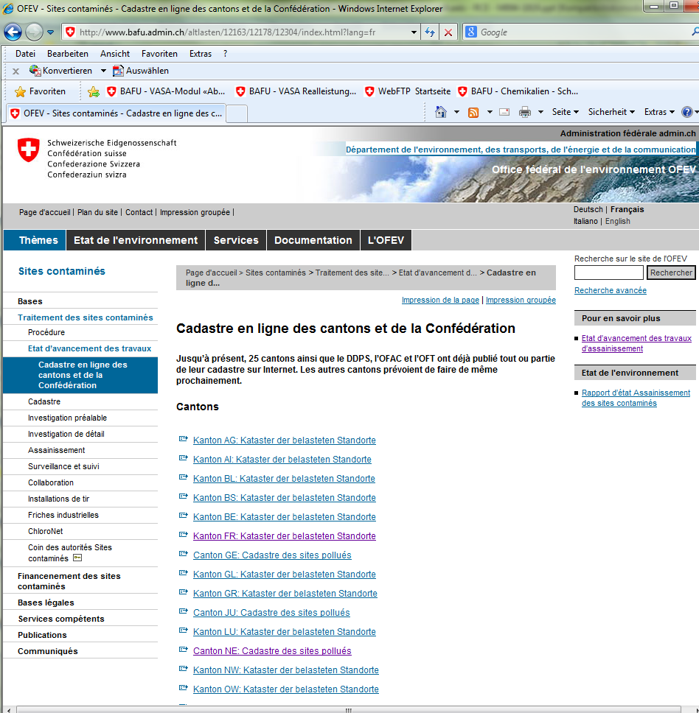
1. Basics - Register of polluted sites
www.bafu.admin.ch/altlasten
Notes:
The cantons and the federal autorhities have fulfilled their tasks and have established the registers.
All registers are know finished and most of them are available online in a geoinformation interface in the internet
Know I show you some examples of some registers of the cantons and federal authorities
You can find a complete list of them on our homepage. (unfortunately only in german and french)

Slide 45
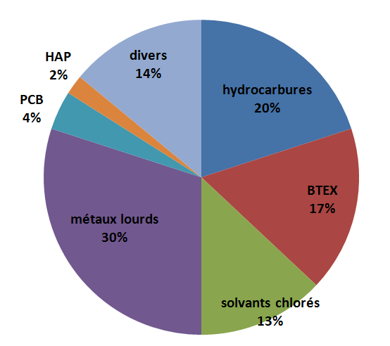
3. Statistics of the pollutes sites
Pollutants responsible for the entry of a site in the register of polluted sites
→ Estimate!
PAK
Other
PCB
Hydrocarbons
Chlorinated hydrocarbons
Heavy metals
solvants chlorés
Chlorinated hydrocarbons
Notes:
Here you see an estimate of the main pollutants that are responisibel for the entry of a site in the ROPS.

Slide 46
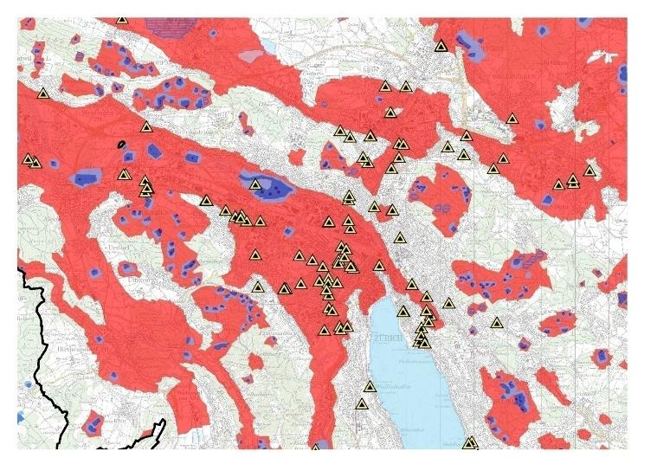
4. Examples of polluted sites
Dry cleanings in Zurich (total 202)
Notes:
Here you see the dry cleaings in the canton of zurich

Slide 47
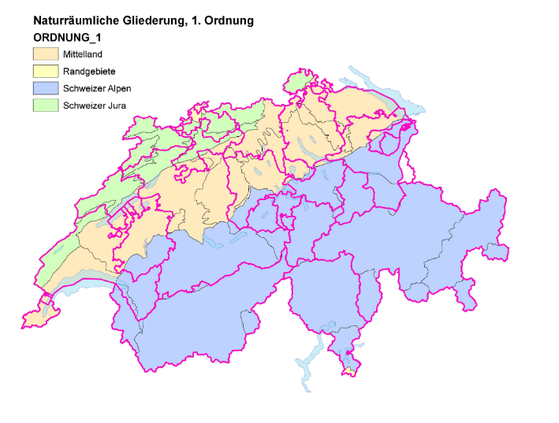
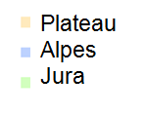
3. Statistics of the pollutes sites
Geographical distribution
Swiss midland
Alps
Jura
Notes:
Her you see Switzerland with the 3 mean geographical areas:
1.
2.
3.

Slide 48
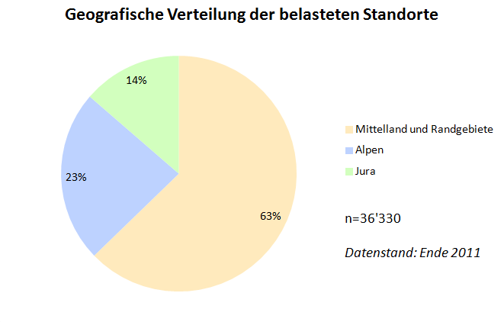
3. Statistics of the pollutes sites
..
Geographical distribution of the polluted sites
Plateau
Alpes
Jura
Swiss midland
Alps
Jura
Notes:
This graph shows the geographical distribution of the polluted sites.
As seen already on the Map before:
Most of the PS are situated in the Swiss Midland

Slide 49
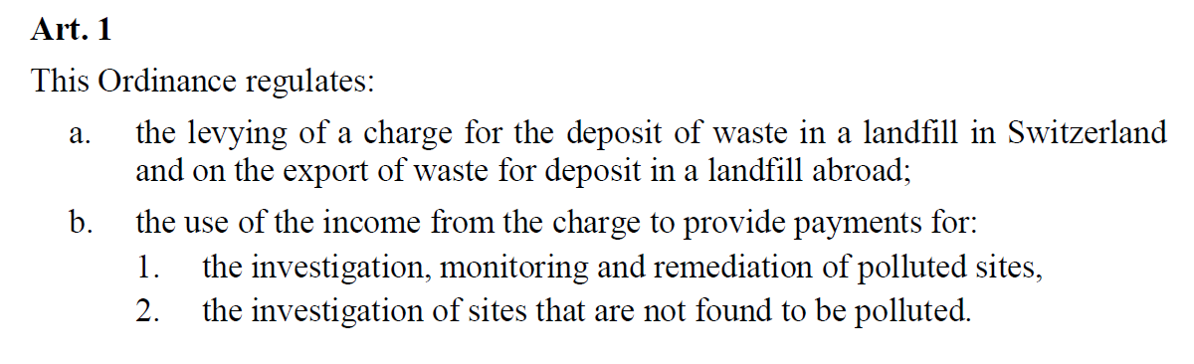
Subsidy by the Ordinance OCRCS (VASA)
Ordinance on the Charge for the Remediation of Contaminated Sites (OCRCS)
Notes:
The VASA is a sort of health insurance, that allows us to help finance (subsidy) under some conditions the registering, the investigations, the monitoring and the remediation of polluted sites.

Slide 50
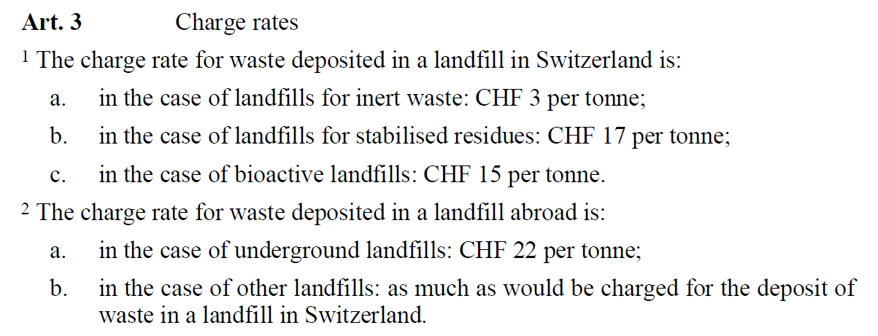
The income
Actually by this charge rates we have an income of
Fr. 40 mio.. per year
Notes:
Here you see the actual charge rates.
They depend from the quality of material deposited.
This charge helps also to reduce the material deposited of in landfills.

Slide 51
What and when do the VASA pays
Fr. 500.- per registered polluted site
40% on the overall costs for investigation, monitoring and remediation if:
  one of the responsibles cannot be identified or is unable to pay, or
  a significant proportion of the waste deposited on the site is municipal waste.
Fr. 8’000.- per target for the investigation and remediation of shooting ranges
40% of the investigation costs if those reveal that the site is not polluted
Notes:
We pay Fr. 500.- for each site registered by the cantonal autorities.
40% of the costs if one of the responsibles is unknown or unable to pay.
40% in case of waste deposit sites with significant proportion of municipal waste.
8’000 francs per target for the remediation of shooting ranges and
40% of the investigation costs if the site reveals to be not polluted.

Slide 52
VASA-Output
Mai 2013
Notes:
On this slide you see the number of subsidy-requests treated yearly in our section.
Each year we have something about 250 requests.

Slide 53
Income and output of the VASA
Mai 2013
Notes:
From 2002 until 2012 we had an income of 360 Mio. Fr. (green column).
On the other side we have about 200 Mio. already payed (blue column) and over 150 Mio. confirmed subsidys (light blue). These confirmed amounts are payed, when the mesures are done.
This is a very good instrument to promote remediations, that probably otherwise are not done and to monitor the practices of the cantonal autoritys.

Slide 54
4. Containment measures
Groundwater-filled gravel-channel
landfill
marl
sandstone
Notes:
Man hat Sofortmassnahmen ergriffen.

Slide 55
4. Excavation quantities
tons
Top layer (soil)
Waste
Bottom (rock)
Notes:
Was war auszuheben. 20’000 LKW-Ladungen.

