Slide 1
Mercury contamination in the Canton Valais, Switzerland
Workshop
Remediation of Historically Polluted Areas – in Sarkandaugava
Ingo Schoppe, 1st June 2017

Slide 2
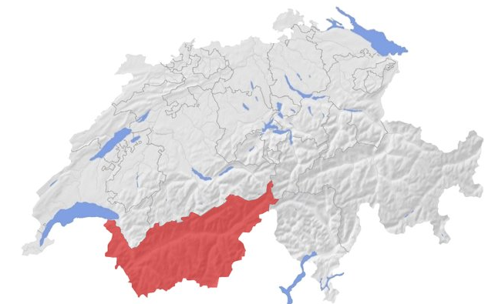
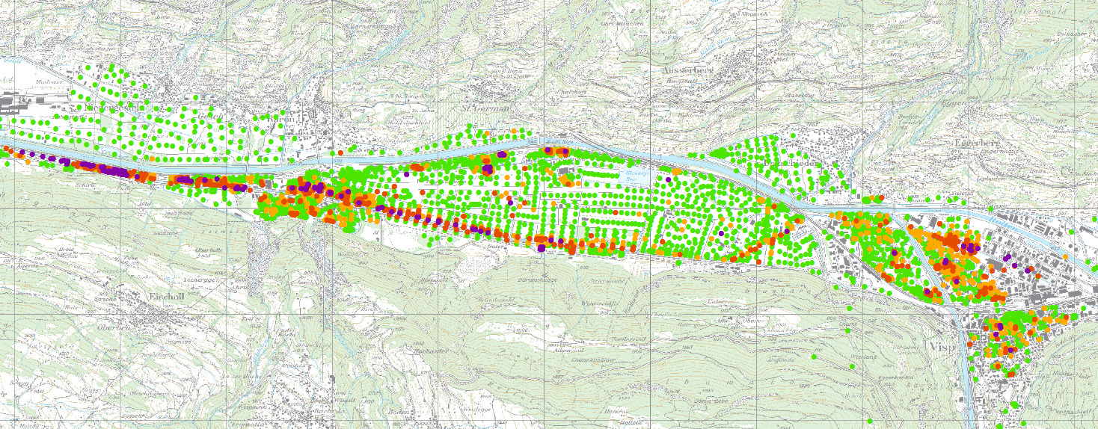
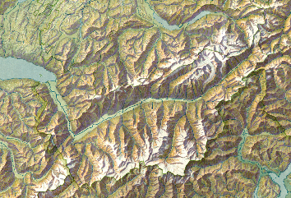
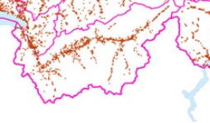
Geographic situation
Sources:
Map : http://www.apgmontagne.ch/de/werbemarkt/abdeckung/wallis/
Extract 1: http://www.reliefs.ch/schweizerkarte_klein.jpg
Extract 2: https://www.bafu.admin.ch/bafu/de/home/themen/altlasten/fachinformationen/altlastenbearbeitung/stand-der-altlastenbearbeitung-in-der-schweiz.html
Extract 3: https://www.swisstopo.admin.ch/de/home.html

Slide 3
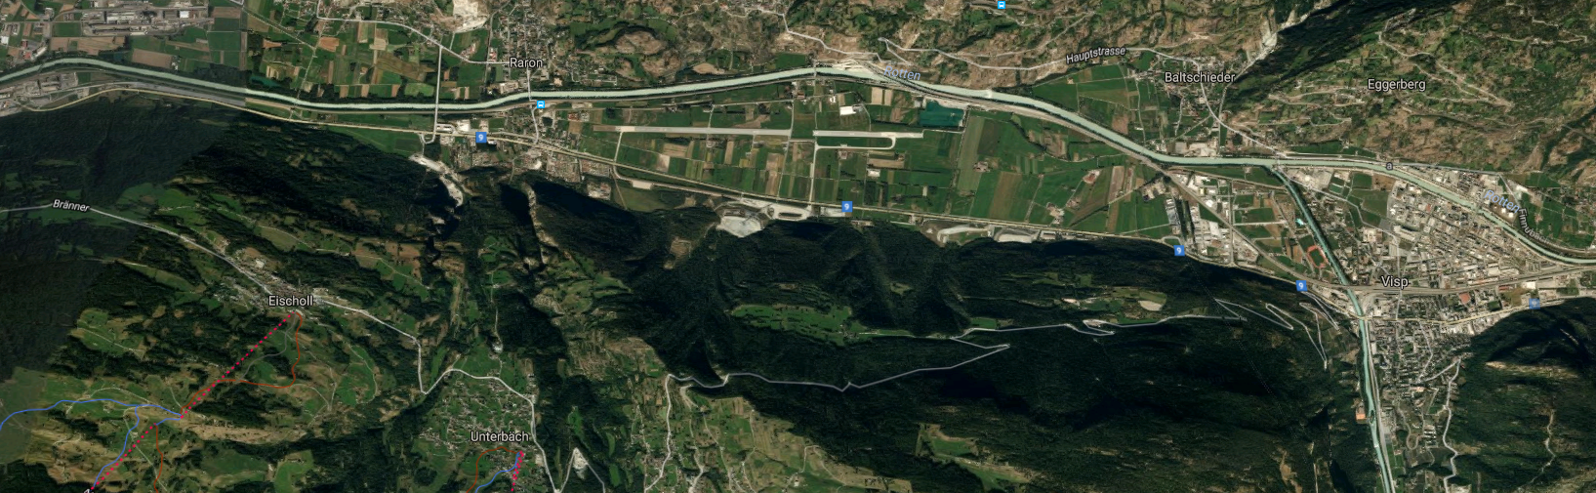
Location
Source: https://www.google.ch/maps/@46.2910986,7.8244467,6055m/data=!3m1!1e3

Slide 4
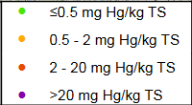
Current situation
Source: https://www.vs.ch/documents/19415/1019553/Gesamt%C3%BCberblick+der+Quecksilbergehalte/3f0b4e84-ec54-4530-b6b2-cec5aaf1aaed

Slide 5
Legal situation
Urban area | Rural area | Action
Hg < 0,5 mg / kg | Hg < 0,5 mg / kg | No action
Hg between 0,5 and 2,0 mg / kg | Hg between 0,5 and 20,0 mg / kg | Risk analysis
Hg > 2,0 mg / kg | Hg > 20,0 mg / kg | Remediation

Slide 6
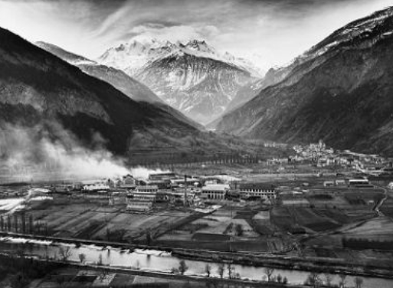
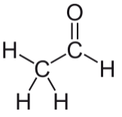
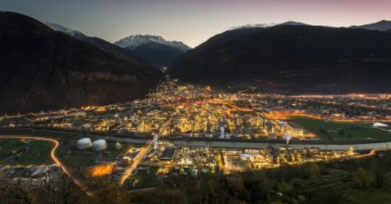
What is the problem?
Production of acetaldehyde (1917 – 2013)
Acetaldehyde: CH₃CHO
Use of acetaldehyde
  Important base ingredience for many chemical applications
Production
For the production of CH₃CHO mercury is needed
as catalyst. Parts of the mercury were lost and discharged with the waste water.
C₂H₂ + H₂O => CH₃CHO
Source:http://history.lonza.com/

Slide 7
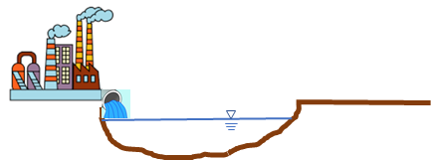
Distribution of Mercury – Step I
Step I:
LONZA got an authorisation to use canal for discharge of waste water
Hg flowed downstream
LONZA has discharged Hg-contaminated water
During the Production of acetaldehyde between 1917 – 1970 *
* After 1970 the environmental awareness increased and the environmental laws became more strict.

Slide 8

Distribution of Mercury – Step II
Step II:
Municipalities were responsible for maintenance of canal
Hg-contaminated sludge was dug out of the canal
Hg

Slide 9


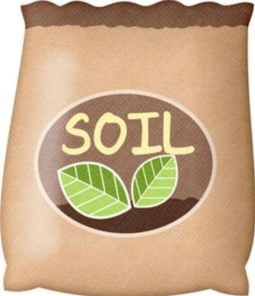
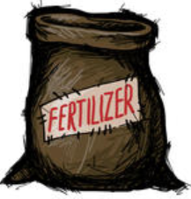
Distribution of Mercury – Step III
Step III:
Hg-sludge was distributed to farmland or stabilisation of wetlands
Nobody knows who were the distributers
?
Hg

Slide 10
What happened between 1917 – 1970?
Step I:
LONZA got an authori-sation to use canal for discharge of waste water
Hg flowed down-stream
LONZA has dis-charged Hg-contaminated water
Step II:
Municipalities were responsible for maintenance of canal
Hg-contaminated sludge was dug out of the canal
Step III:
Hg-sludge was distributed to farmland or stabilisation of wetlands
Nobody knows who were the distributers

Slide 11
Project design
Technicial consideration
Administrativ consideration
PCB
PAK
Heavy metals
Polluters
Land owners
Administration
Mercury
Cocktail
=> Technical complexity is rather simple
=> Administrativ complexity is challenging

Slide 12
Emotional aspect
„The contamination with Mercury jeopardized the health of
my family, especially my children“
  For a concentration below 0,5mg Hg/kg TS the soil is considered to be clean, for a concentration between 0,5 – 2 Hg/kg TS the soil is polluted, but a remediation is not requested.
„The price for the land parcel is caused by the pollution and the entry in the cadastar of polluted sites decreased by 50‘000 EURO and even more“
  A full decontamination (to a concentration below 0.5 mg Hg/kg) of a polluted parcel costs in general less that 10‘000 EURO.

Slide 13
Who is responsible or has to pay?
Lonza:
Discharged Hg
Not dug out sludge
Not distributed soil
Municipalities:
Maintained canal
Engaged companies
Not distributed soil
Distributers:
Distributers are unknown
After 50 years barred
No company with significant turn over left
=> LONZA pre-finance the investigation and remediation measures without acceptance of legal responsibility

Slide 14
Summary
Heterogeneity of the pollution
Residents are emotional involved
Remediation of contaminated parcels is possible
LONZA pre finances investigations and remediation
Administrative complexity
Difficult to identify all responsibles

Slide 15
