Slide 1
Remediation of historically polluted sites in Sarkandaugava
PERFORMANCE AND GENERAL RESULTS
Dr. Henning Wallner

Slide 2
About INTERGEO
INTERGEO is an independent company represented on four continents (in more than 20 countries) offering engineering and consulting services for environment and planning. We work for a number of clients in both the public and private sectors and provide our clients with goal-oriented, sustainable, economic and innovative answers to their questions. INTERGEO offers expert knowledge and expertise in a number of areas, including the Investigation and Remediation of Soil and Groundwater, Engineering Geology, Environmental Protection and Work Safety as well as Waste Management.
INTERGEO has performed over 10.000 soil and groundwater investigations in Europe and overseas since being founded in Salzburg (Austria) in 1983. We provide a single source for all services – from the investigation to the detailed remediation action plan.

Slide 3
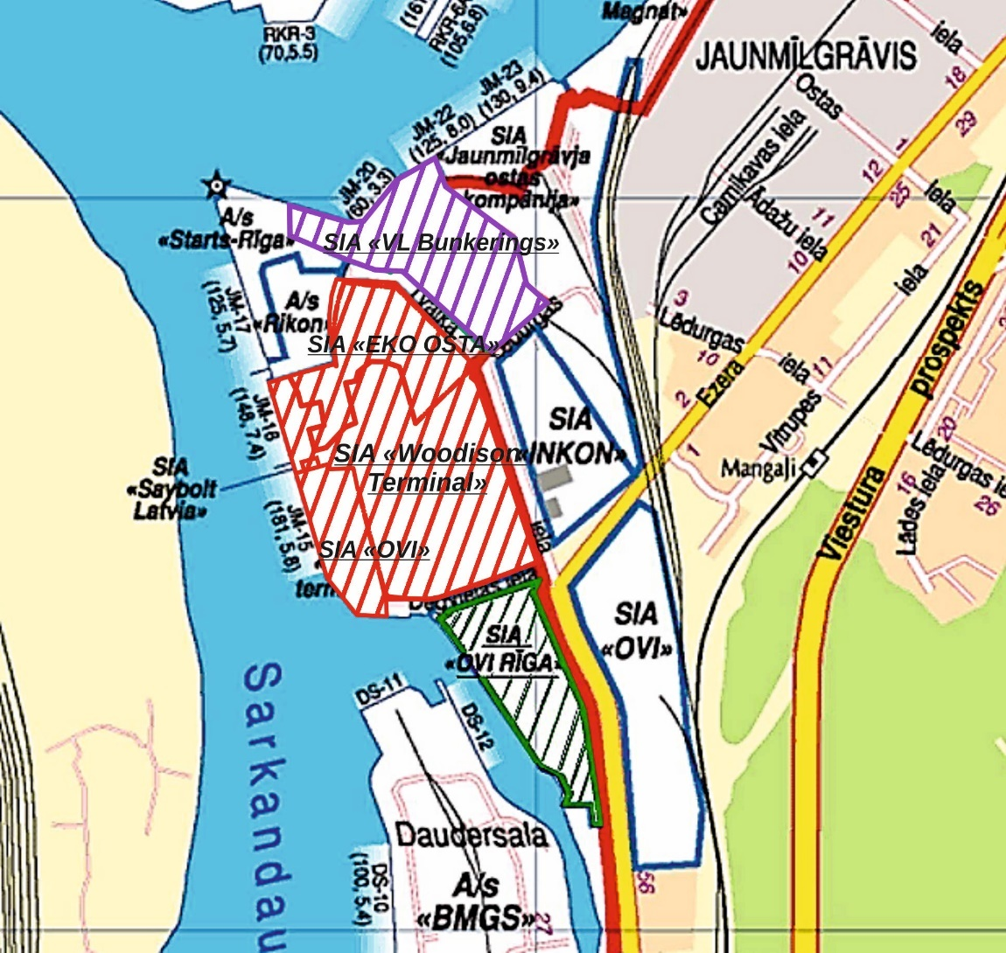
Location of sites

Slide 4
GEOLOGY/STRATIGRAPHY
Pleistocen, Holocen (Quaternary): glacigenous, limnological and fluviatile sediments with a thickness of up to 46 m
fine grained sand, silty (ca. 8 m) → „alluvial“, fluviatile
fine grained sand (ca. 40 m) → limnoglacial sediments of the baltic ice lake
poorly sorted gravely sand to silty sand (ca. 5 m) → moraine
„Devonian sandstones“ (ca. 270 m)
East European platform

Slide 5
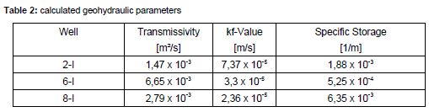
HYDROGEOLOGY
porous aquifer
unconfined system
aquifer is subdivided by a silty layer into 2 sub-aquifers (A1, A2) with a thickness of up to ca. 20 m (depending)
confining bed (aquiclude) 20 to 40 m
aquifer is hydraulically connected to receiving watercourse
GW-Level ca. 2,0 to 3,5 m (bgl)

Slide 6
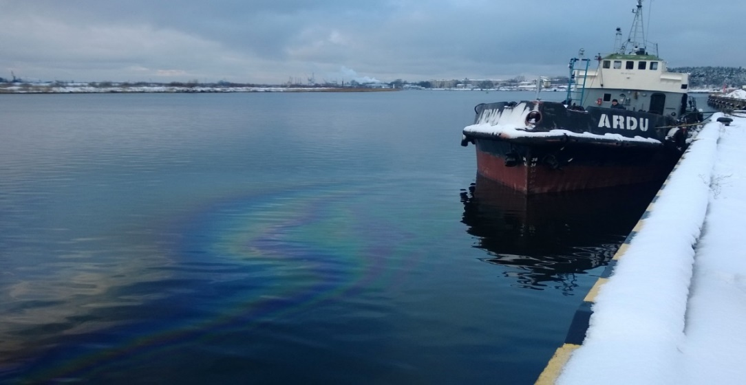
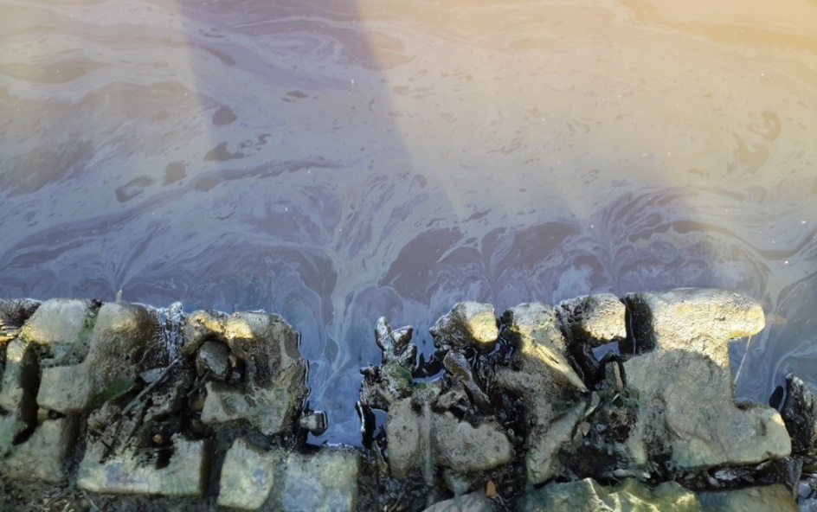
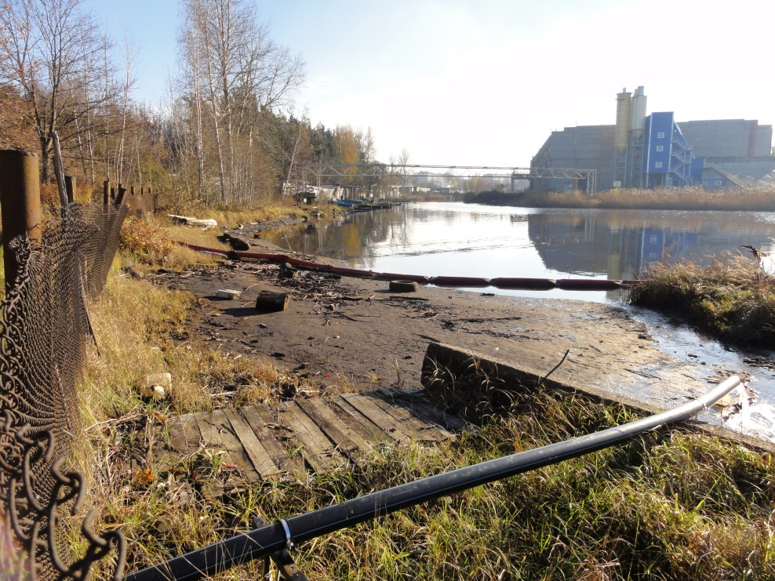
Remediation background
Site I
Site II
Site III

Slide 7
Site I and Site II (Woodison Terminal, Eko Osta, VL Bunkerings, OVI)
General facts
Project execution: | Feb. 2013 – Feb. 2017
Area of contamination: | 5,5 ha
Technical design projects: | 3
Groundwater remediation wells: | 25
Soil clean-up infiltration wells: | 440

Slide 8
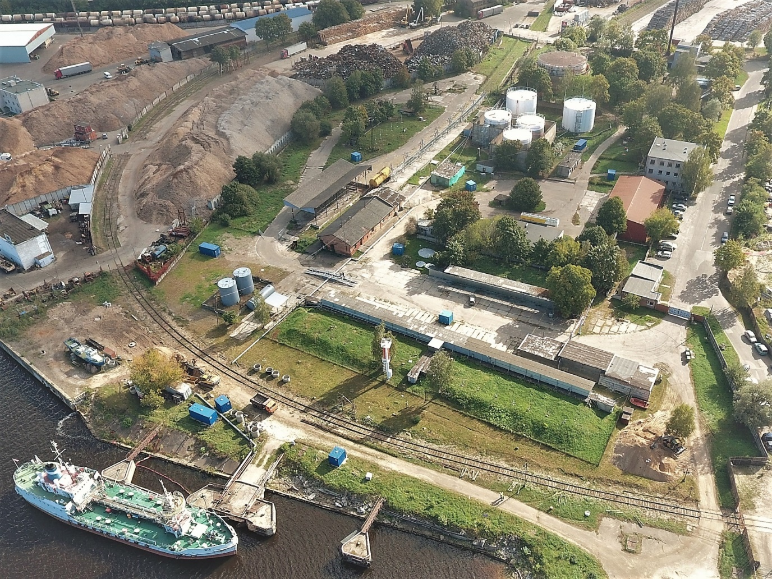
Treatment of groundwater

Slide 9
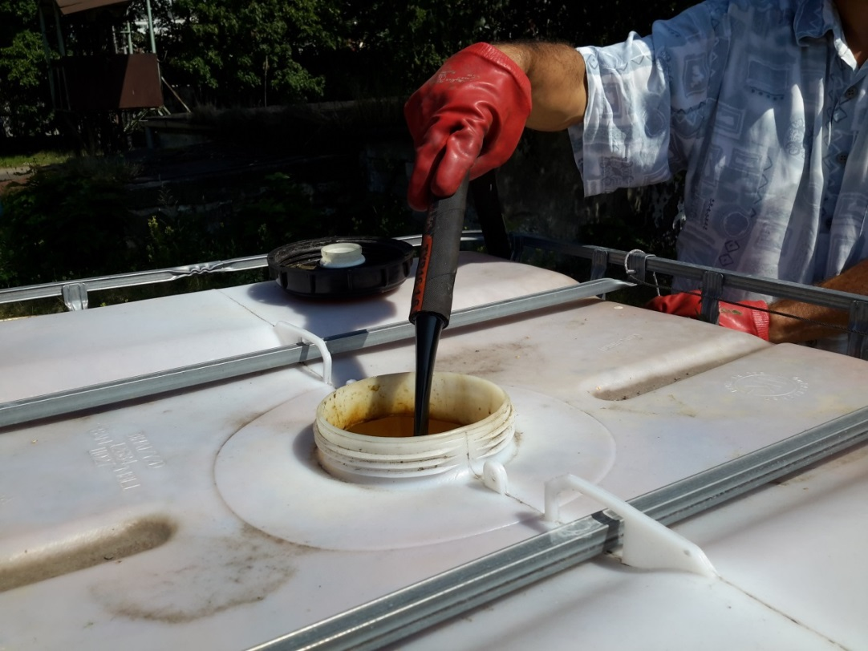
Treatment of groundwater

Slide 10
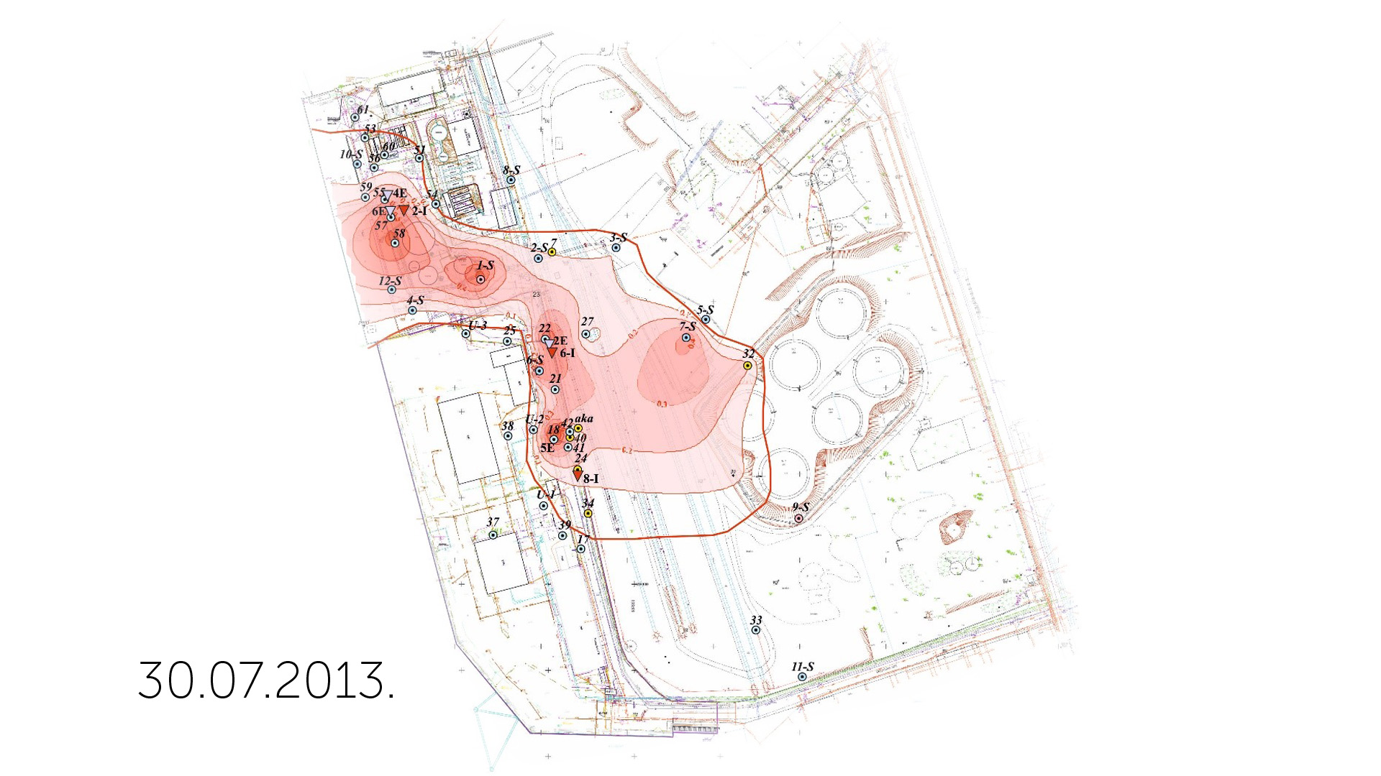

Slide 11
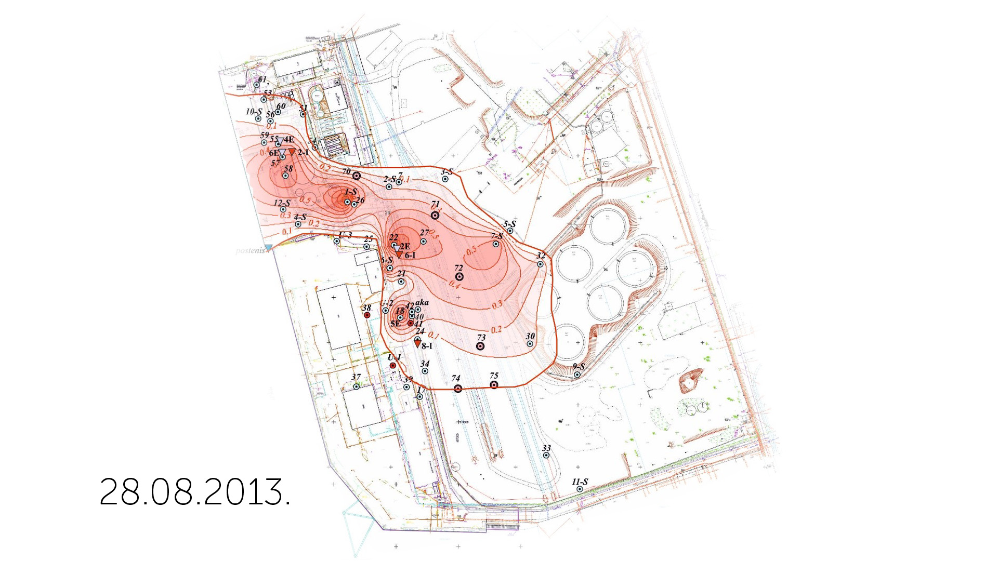

Slide 12
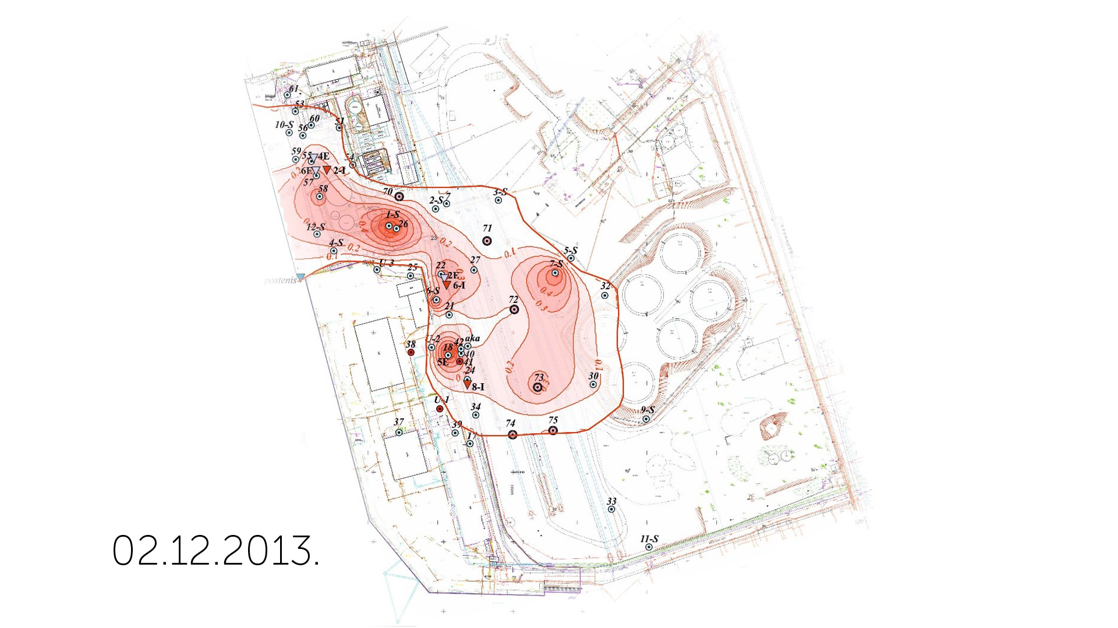

Slide 13
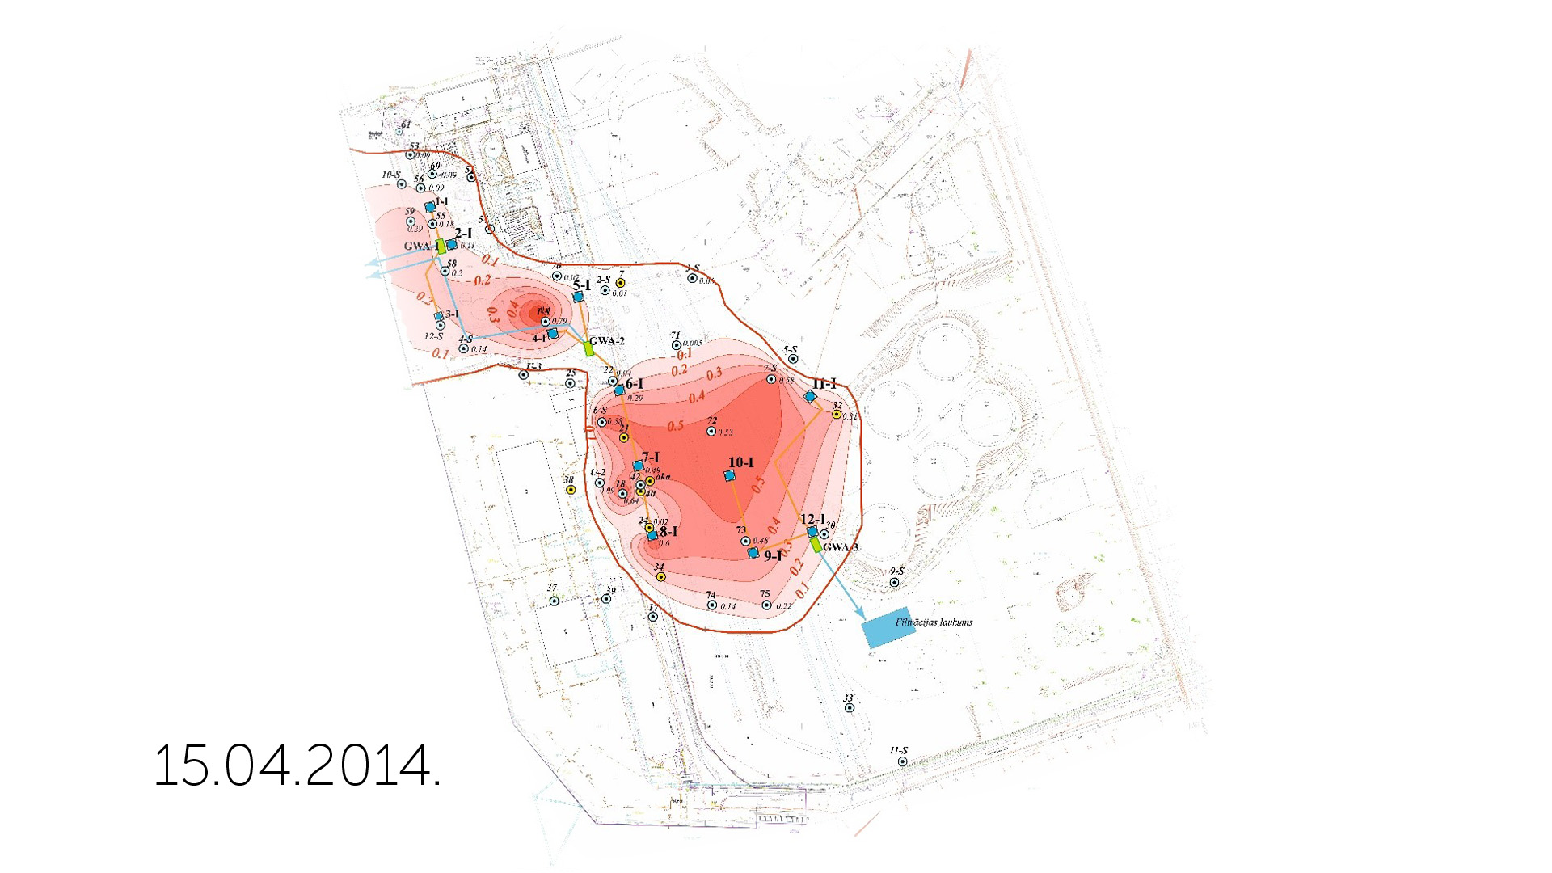

Slide 14
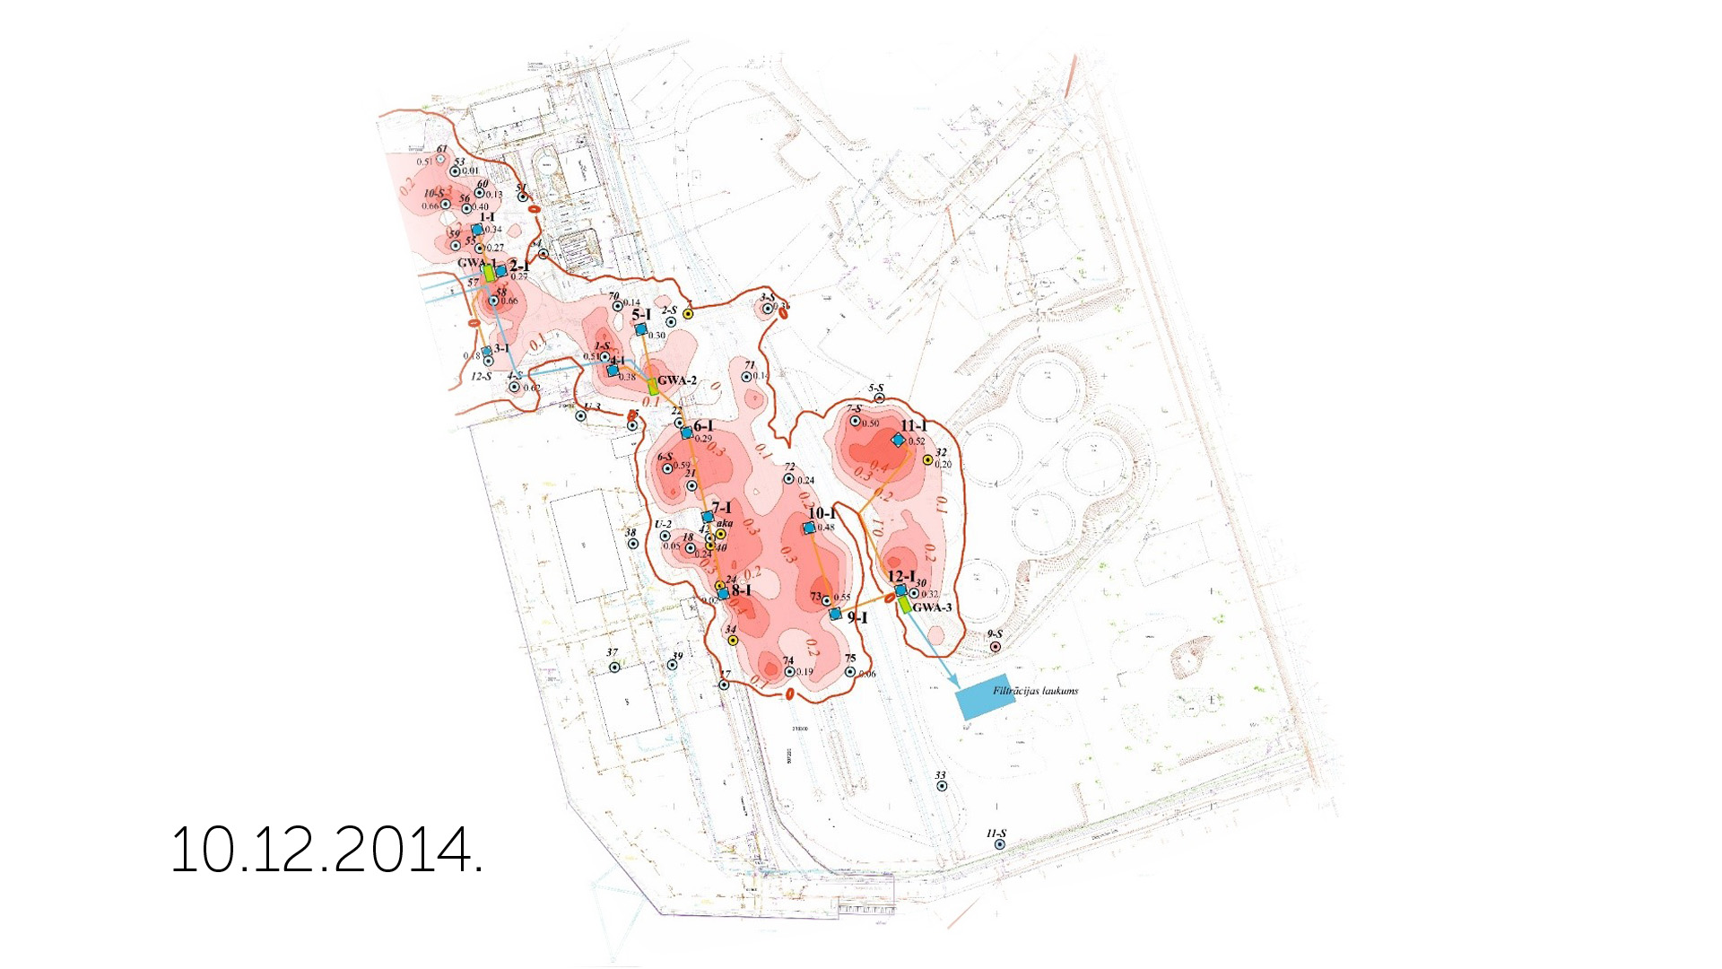

Slide 15
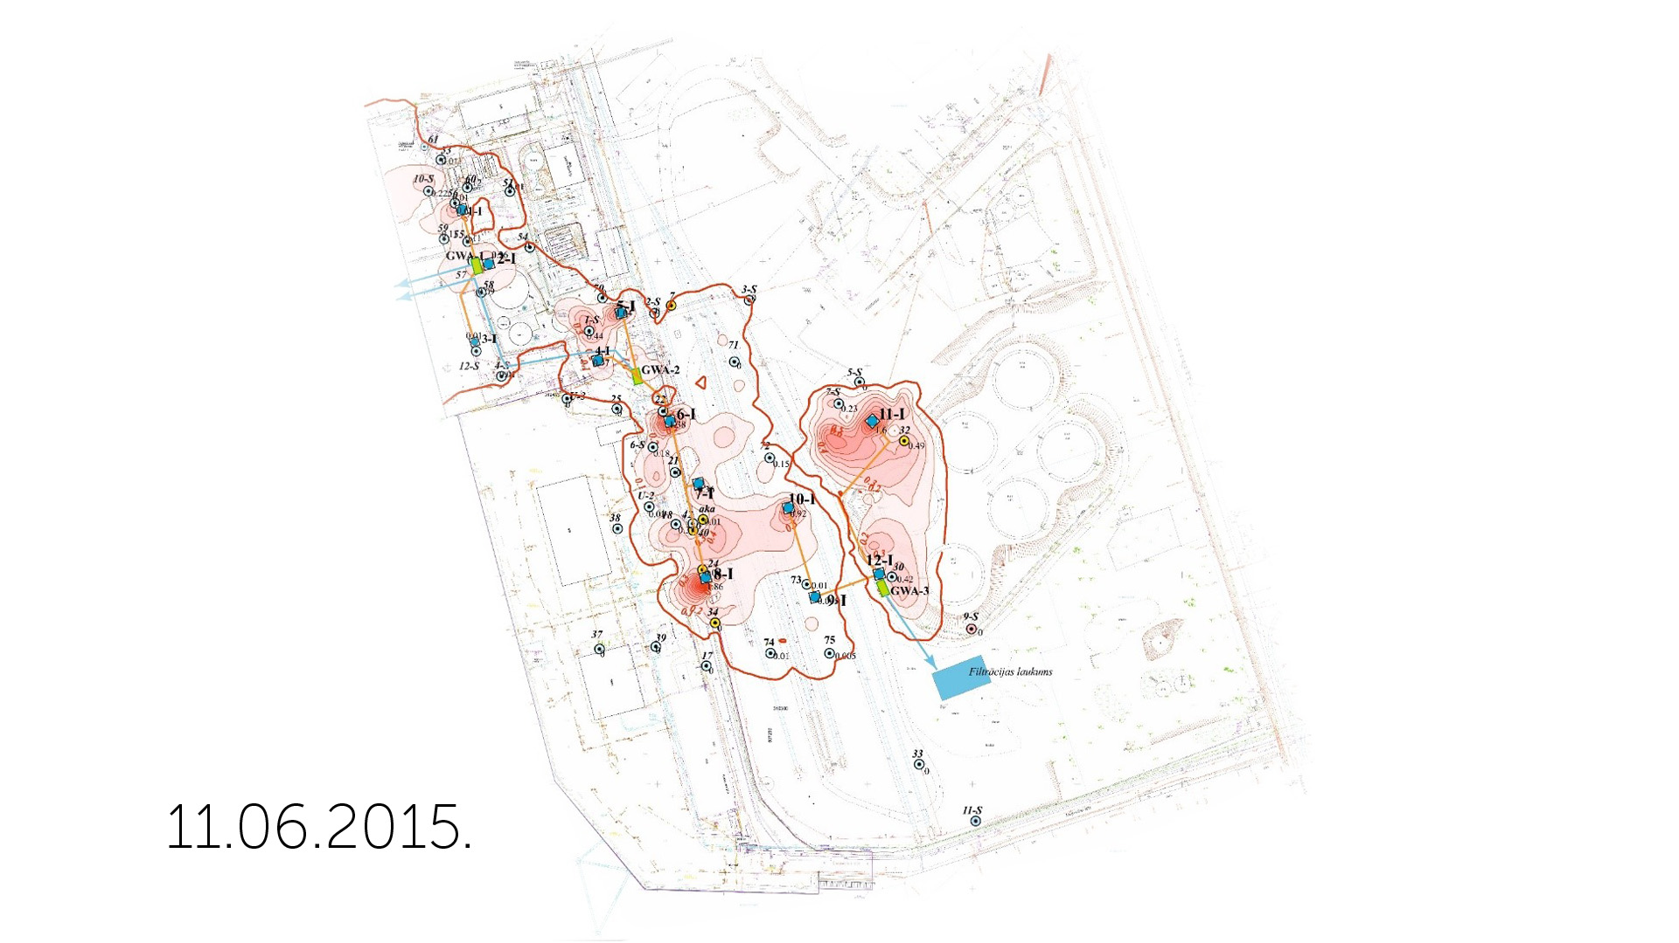

Slide 16
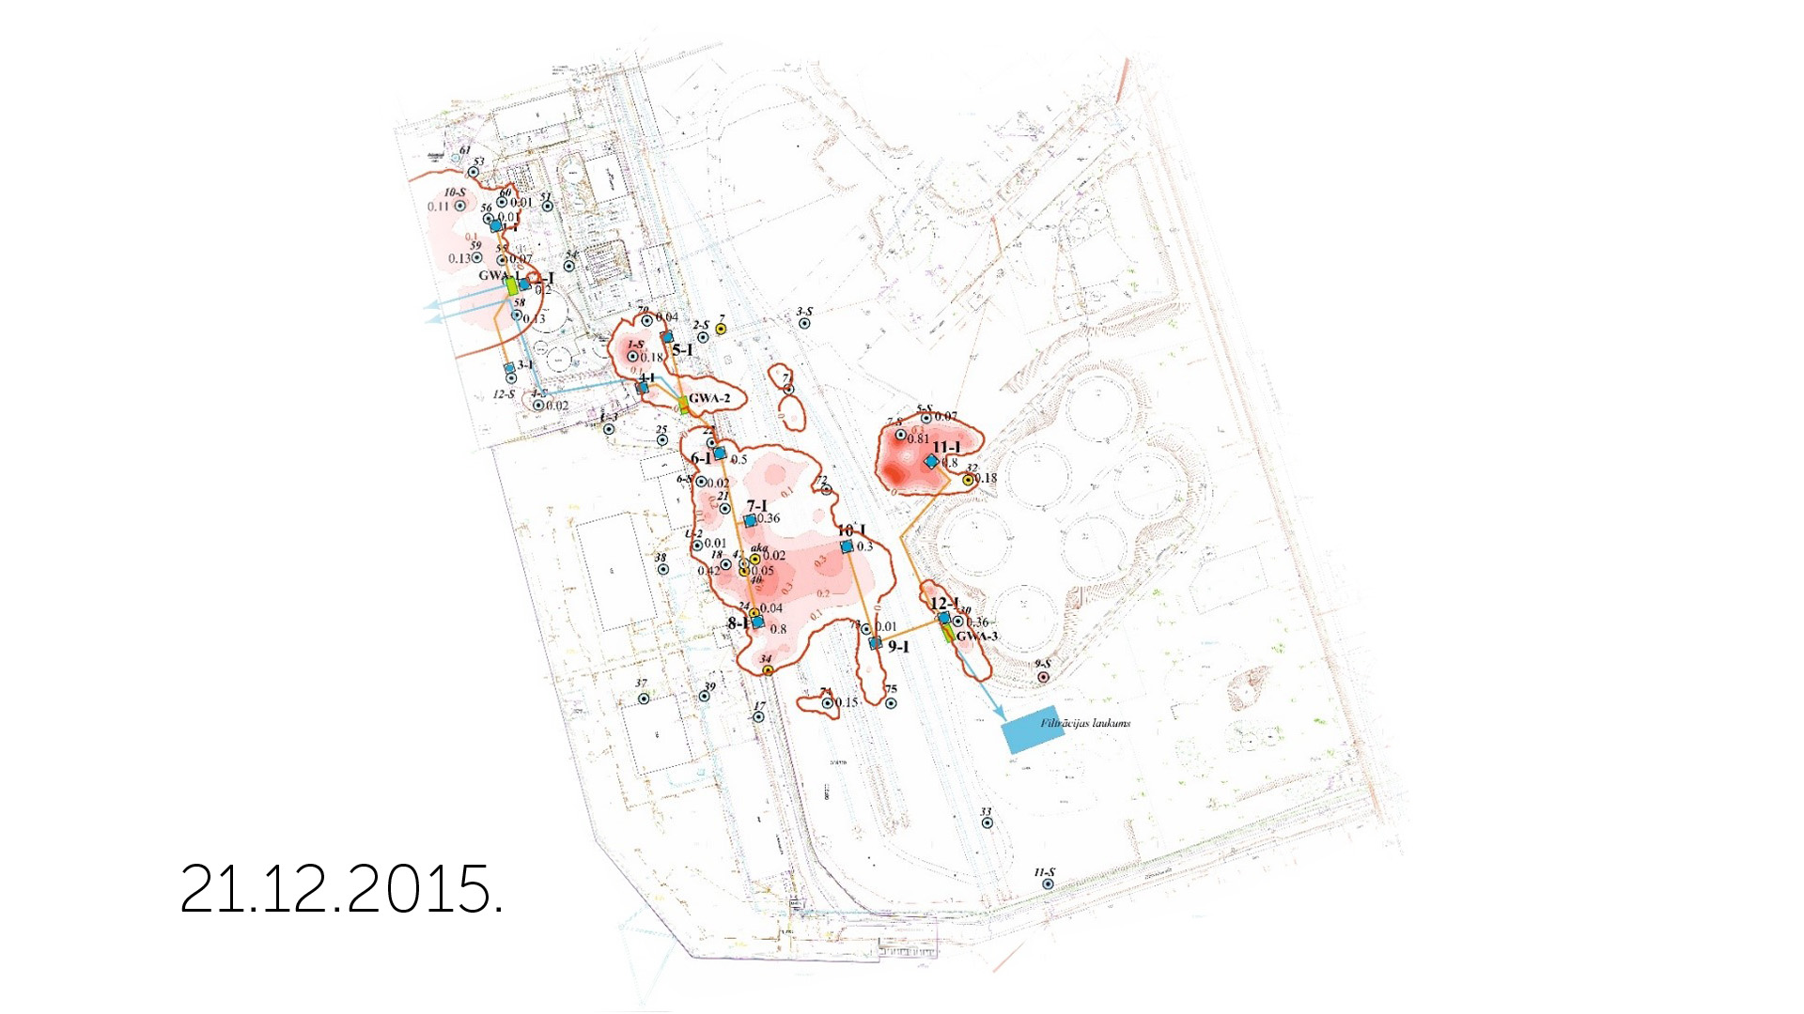

Slide 17
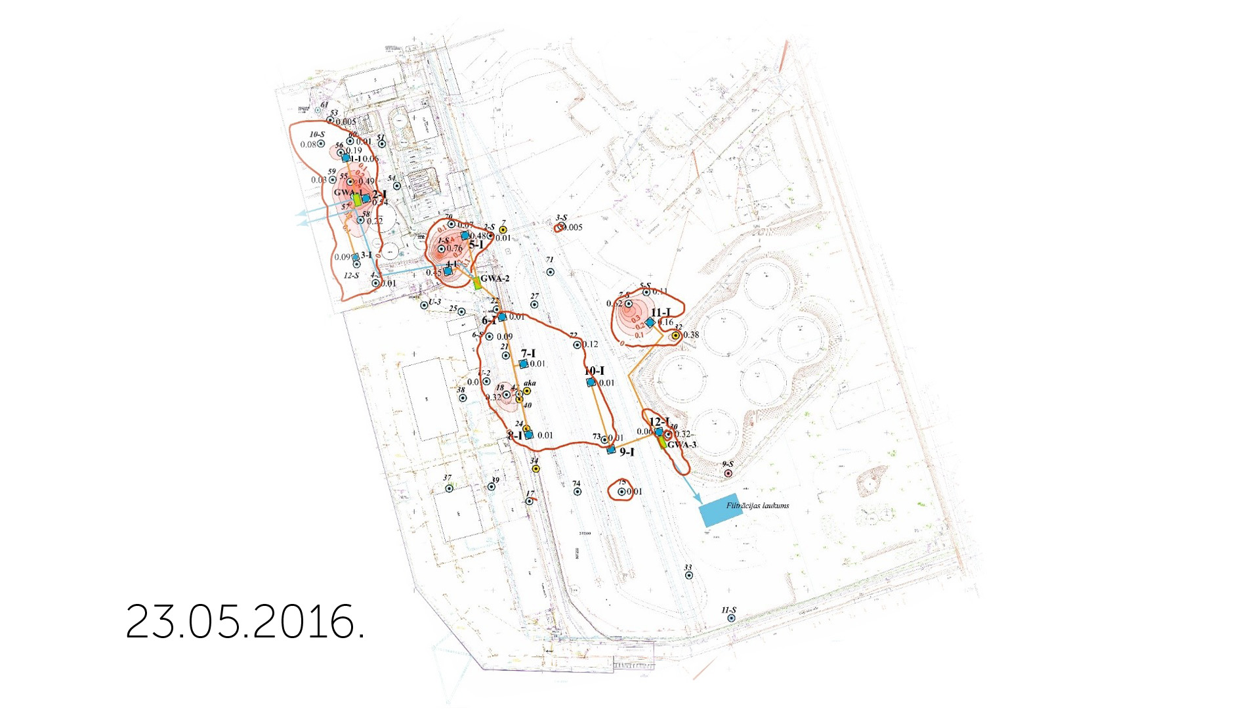

Slide 18
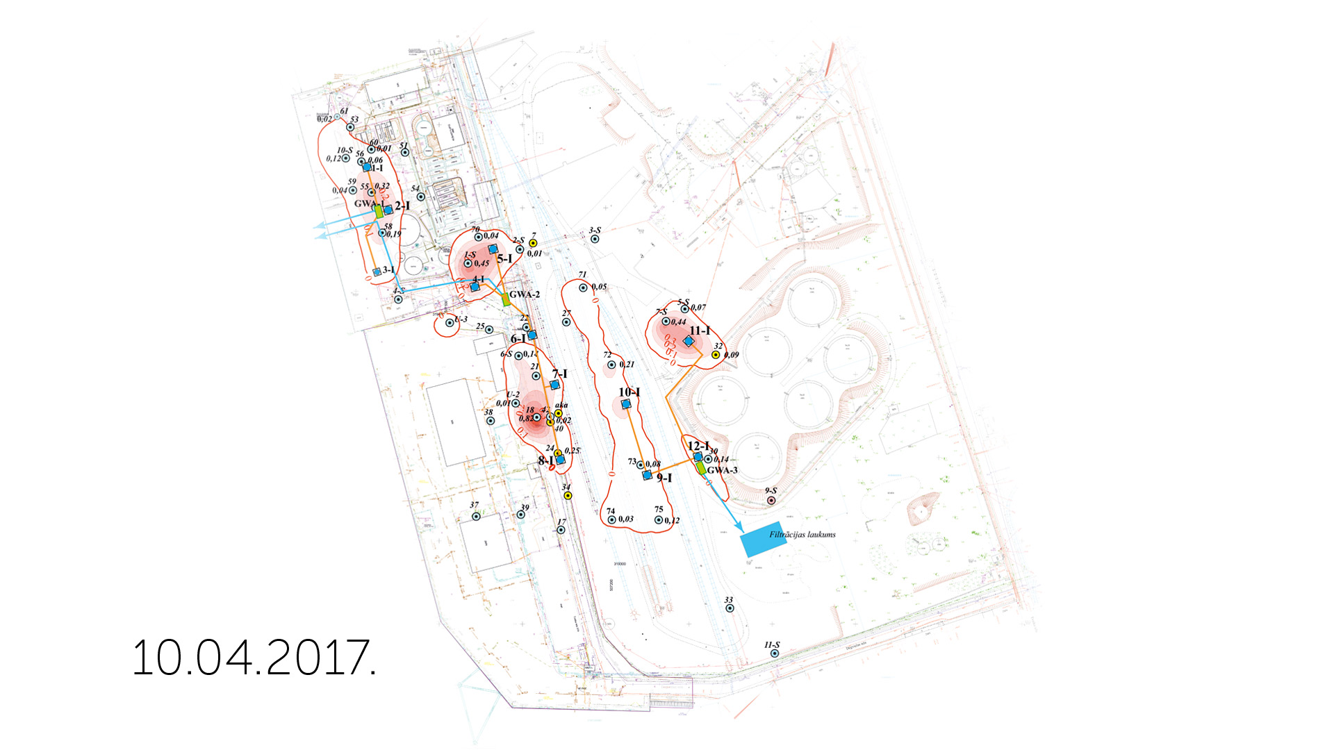

Slide 19
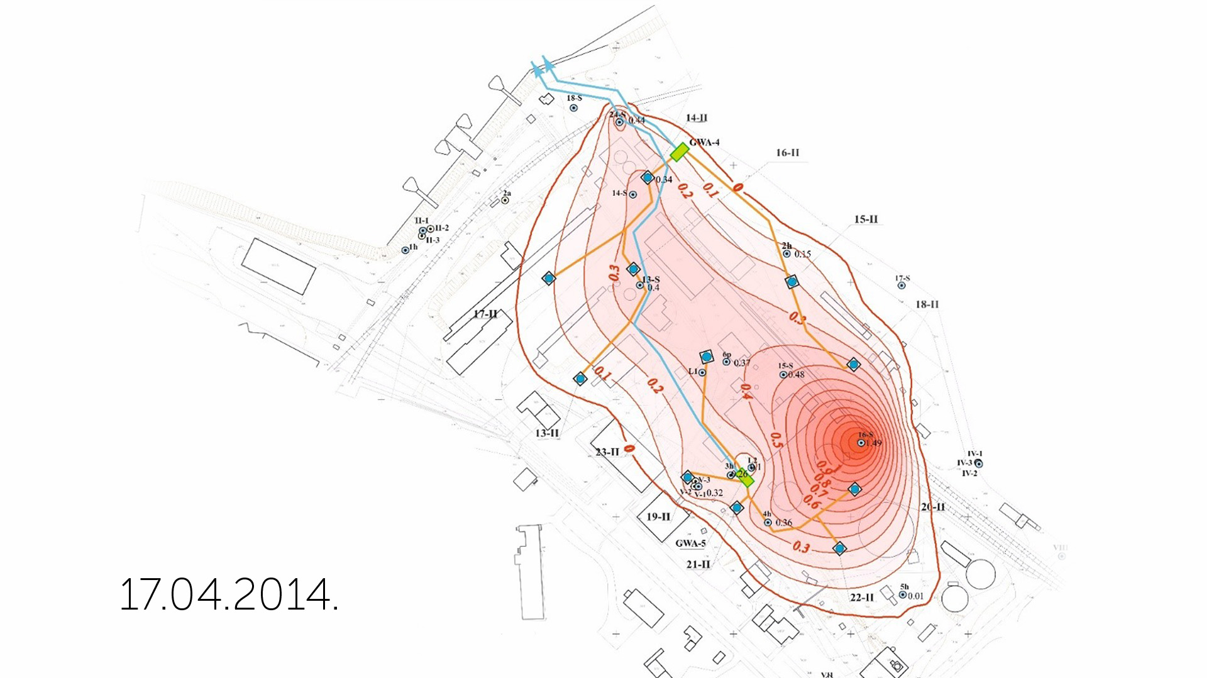
Timelapse Site II

Slide 20
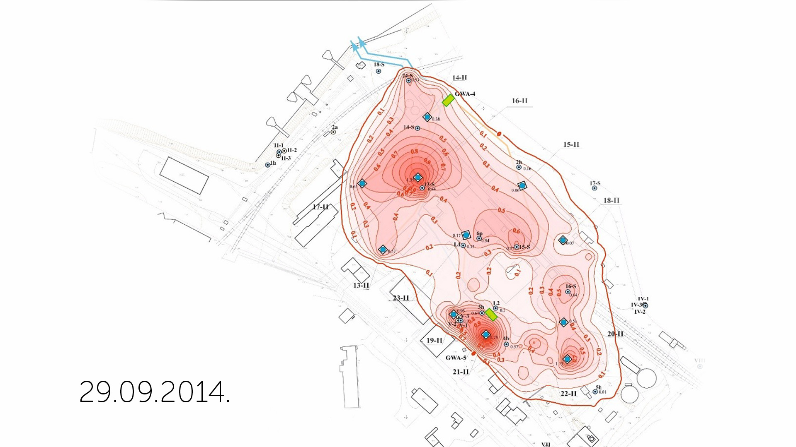

Slide 21
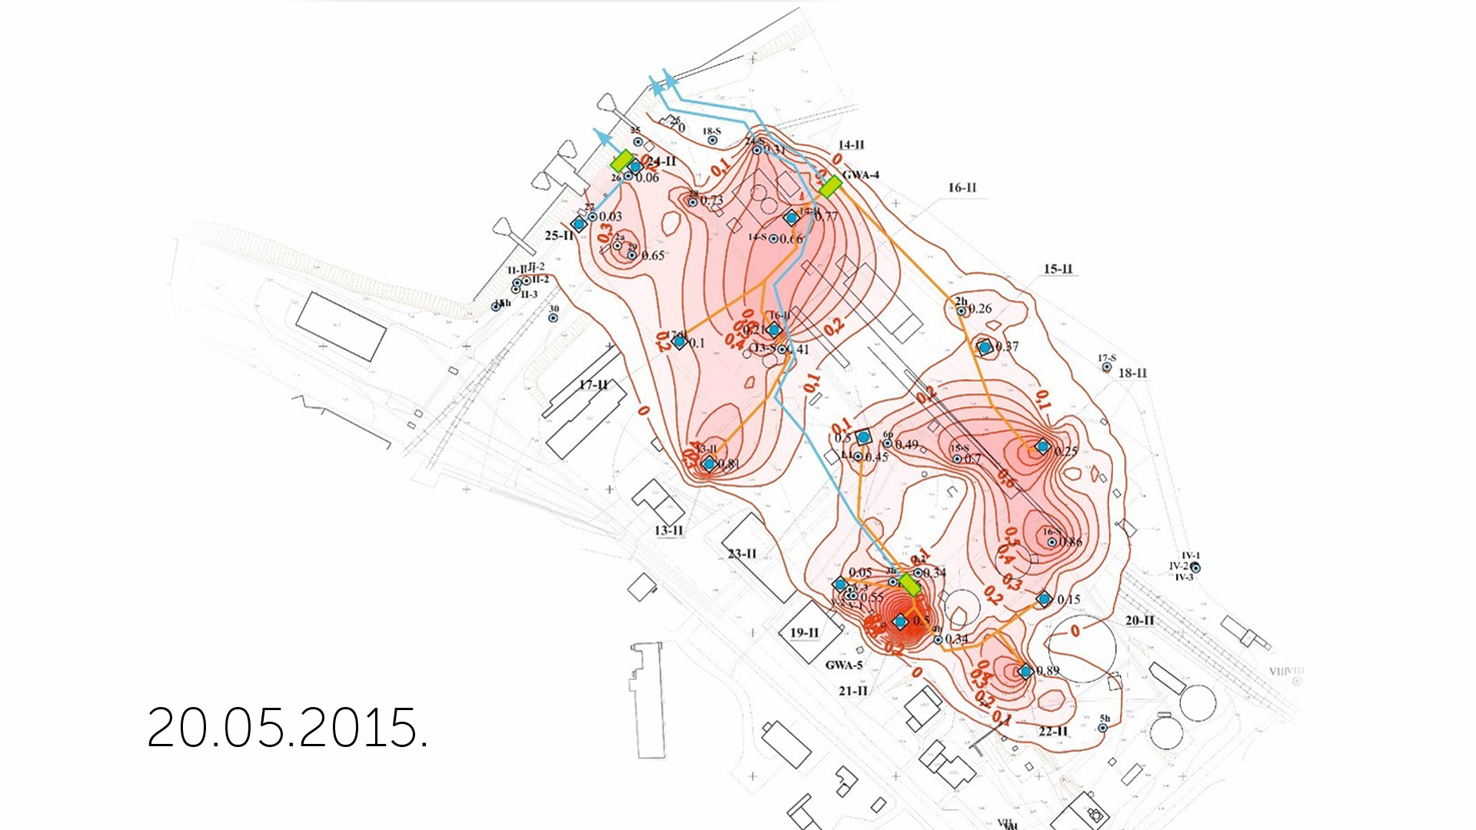
Figure 9: contaminant-concentration vc. depth

Slide 22
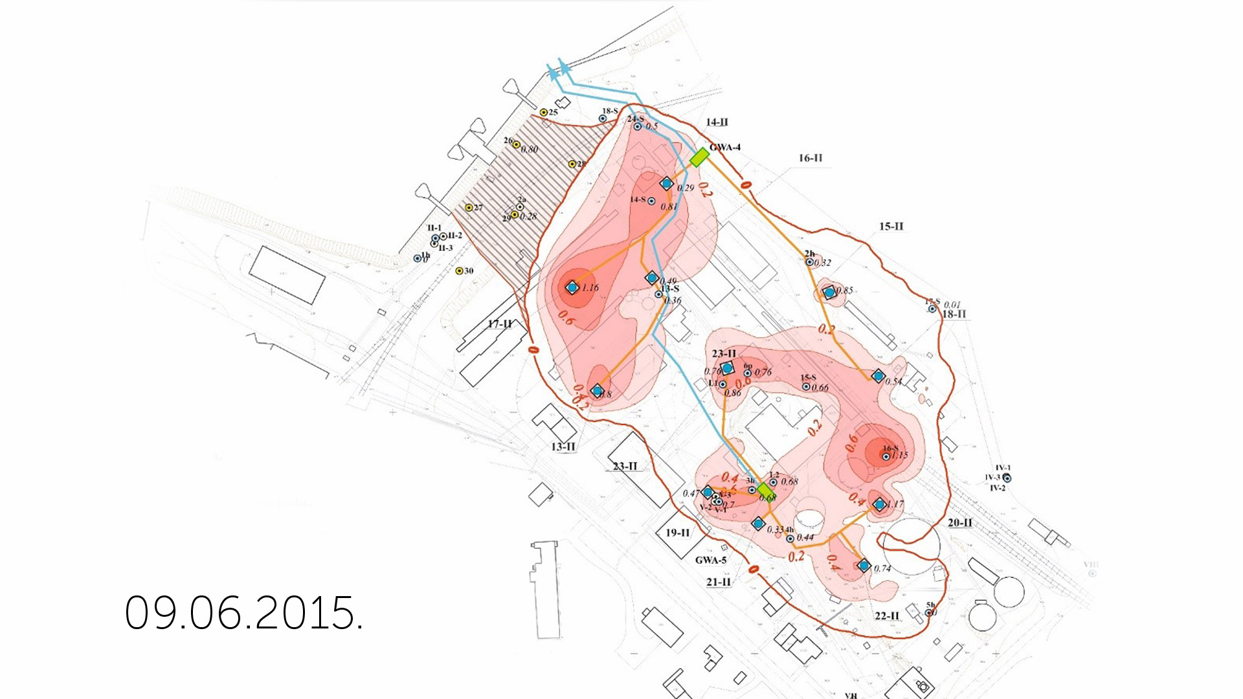

Slide 23
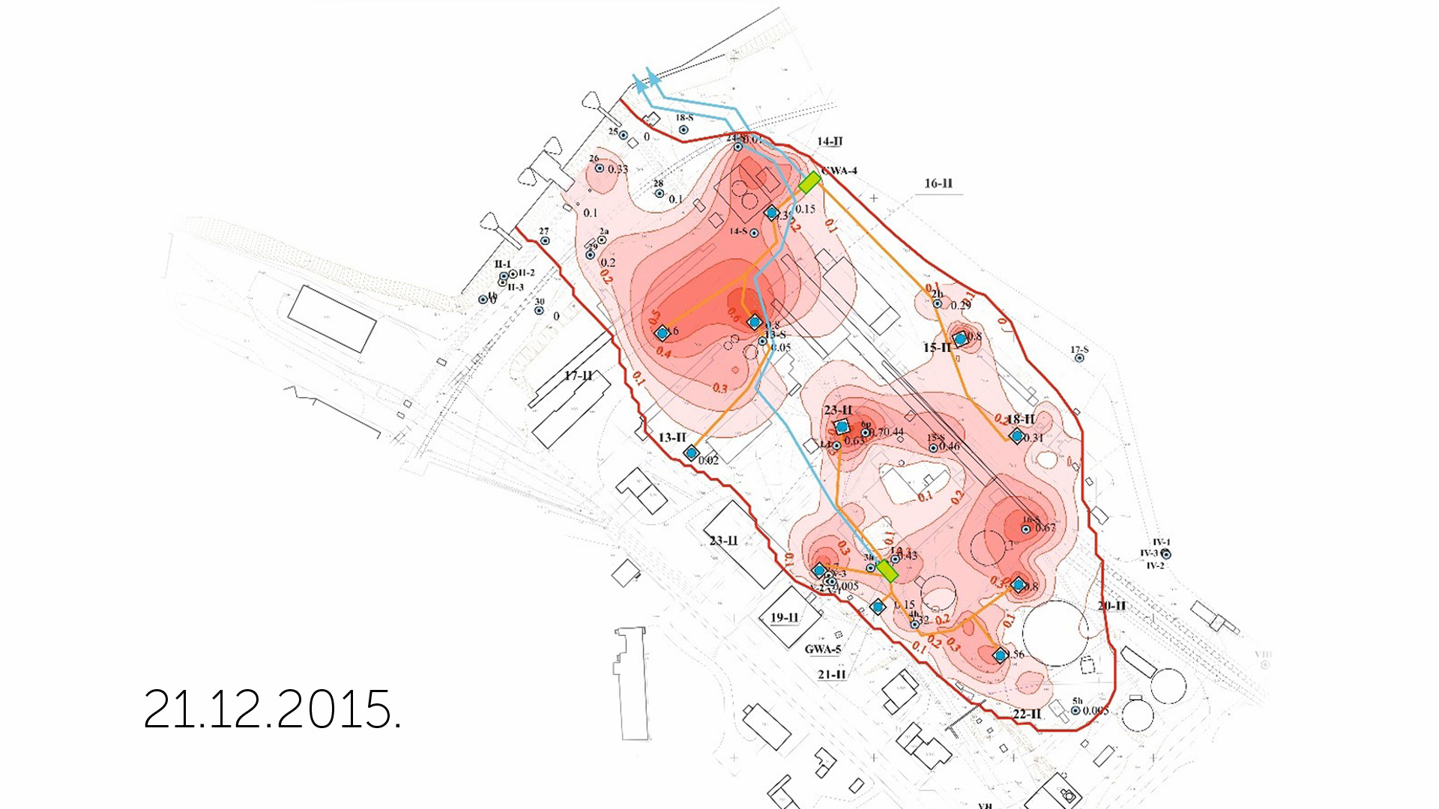

Slide 24
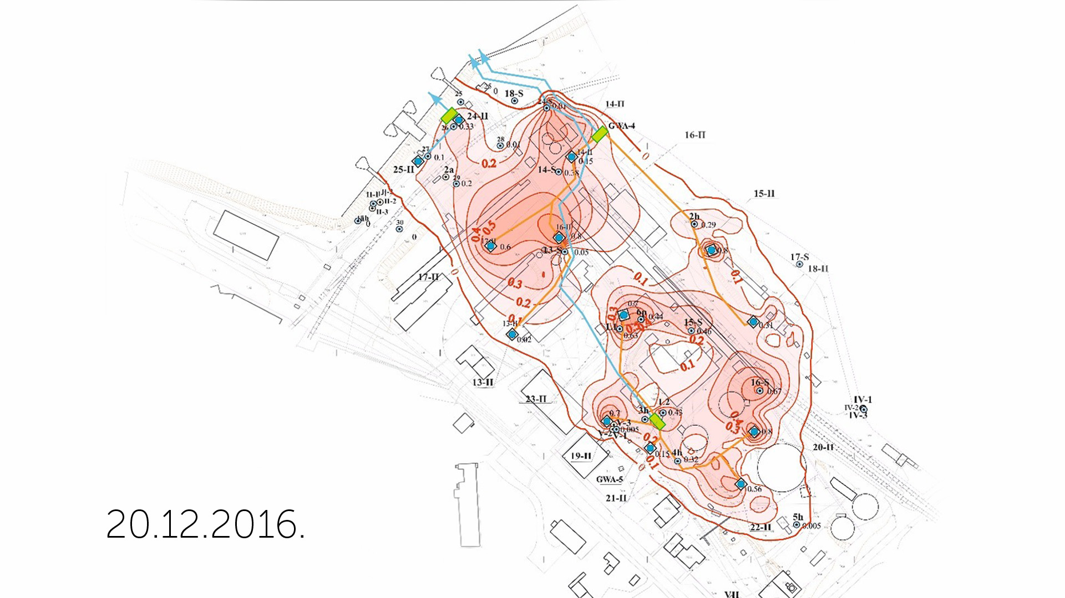

Slide 25
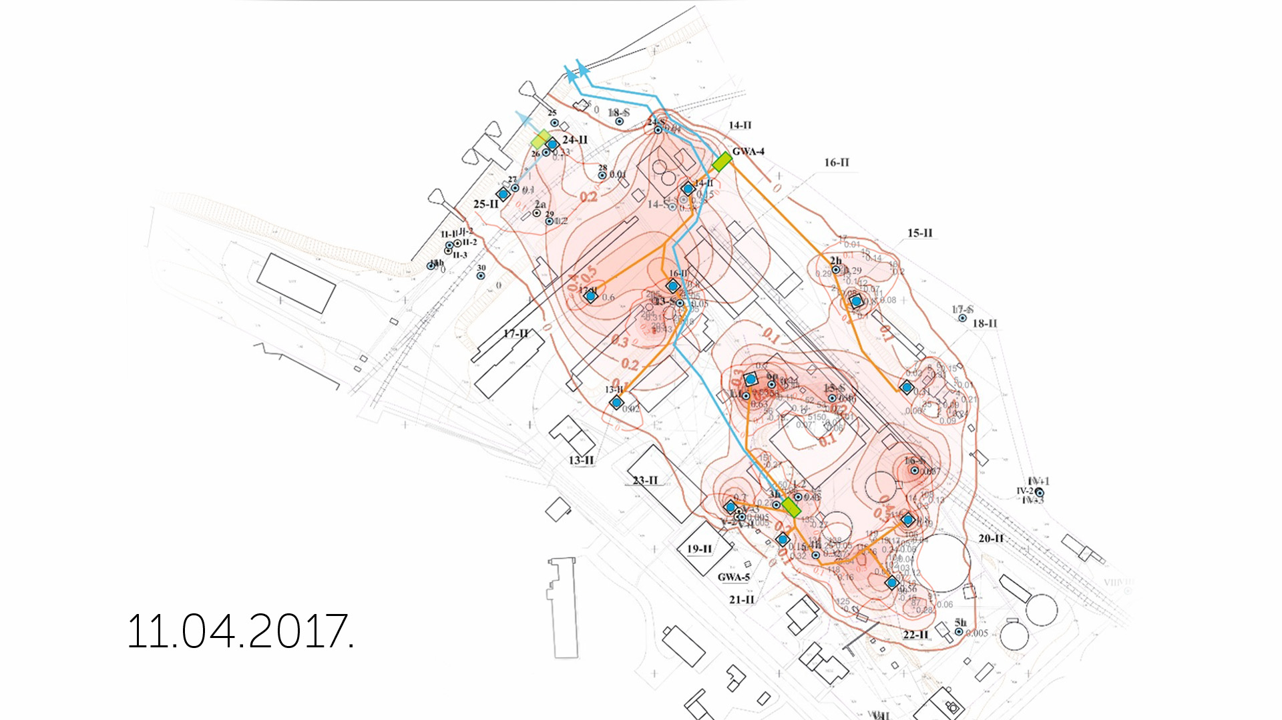

Slide 26
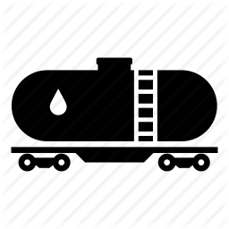
Results - groundwater remediation
Recovered 1165 t of floating oil products;
Regenerated 905`000 m3 contaminated groundwaters with mobile GTP;
Cleaned – up derelict infrastructure;
Improved environmental quality in remediation territory;
Minimized risks of contamination migration outside the remediation zone;
Reduced risks on human health and negative influence on NATURA 2000 protection zone;
Further remediation possibilities for residue contamination and possible new oil spills.

Slide 27
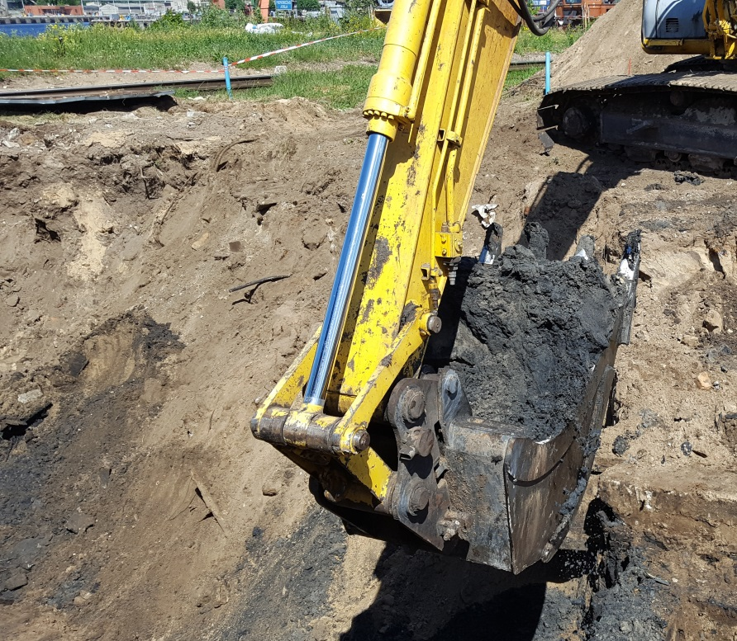
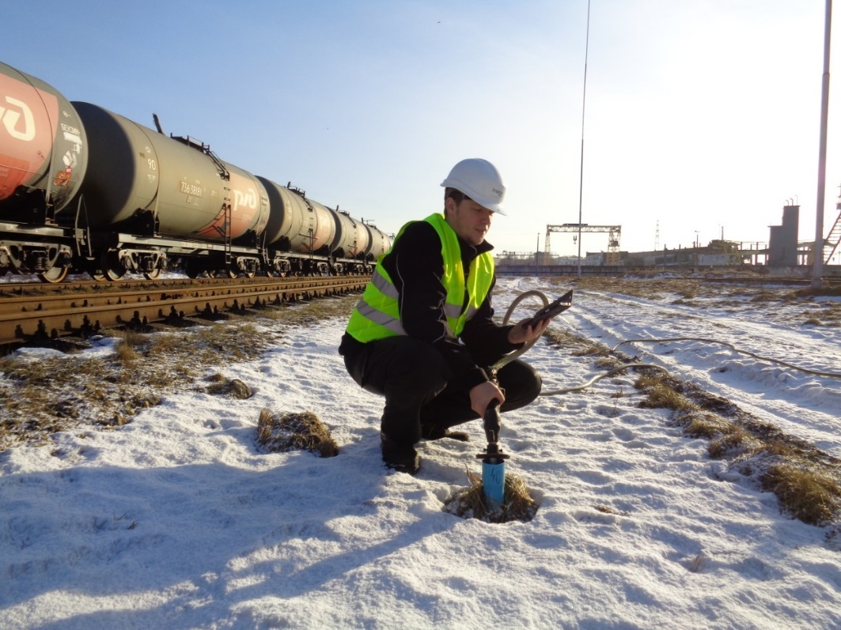
Treatment of soil

Slide 28
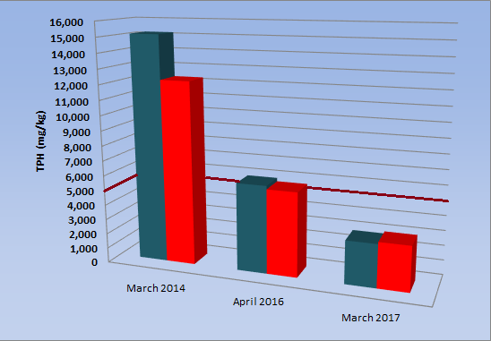
Results – soil remediation
Ex situ: 1`600 t
In situ: 145 t,
reduction of TPH 4-5 times.

Slide 30
Suggestions after remediation
SITE I | SITE II
Periodic pump&treat activities of oil products in areas with negative geological conditions | Periodic pump&treat activities of oil products from drainage system
Clean-up of areas with relatively «new contamination» | Clean-up of areas with relatively «new contamination»
Continious monitoring | Continious monitoring
Territory operator environmental control | Territory operator environmental control
Detailed oil source investigations | Detailed oil source investigations
Management of remaining infrastructure | Management of remaining infrastructure
If necessary, operation of coastline wells to prevent residue contamination migration | If necessary, operation of coastline wells to prevent residue contamination migration

Slide 31
Site III (OVI Riga)
General facts
Project execution: | May 2014 – May 2017
Area of contamination: | 2,5 ha
Technical design projects: | 1
Groundwater remediation wells: | 7 + 3

Slide 32
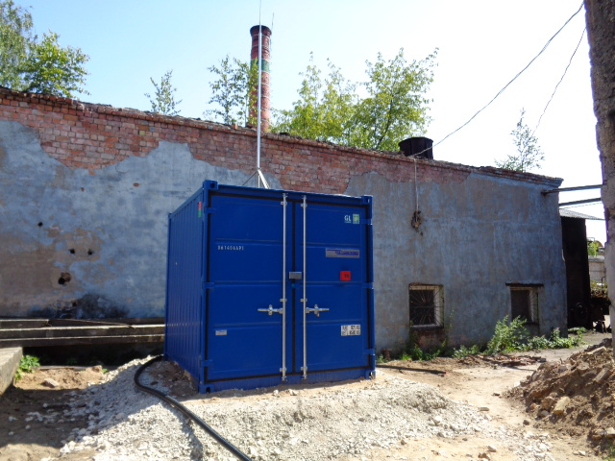
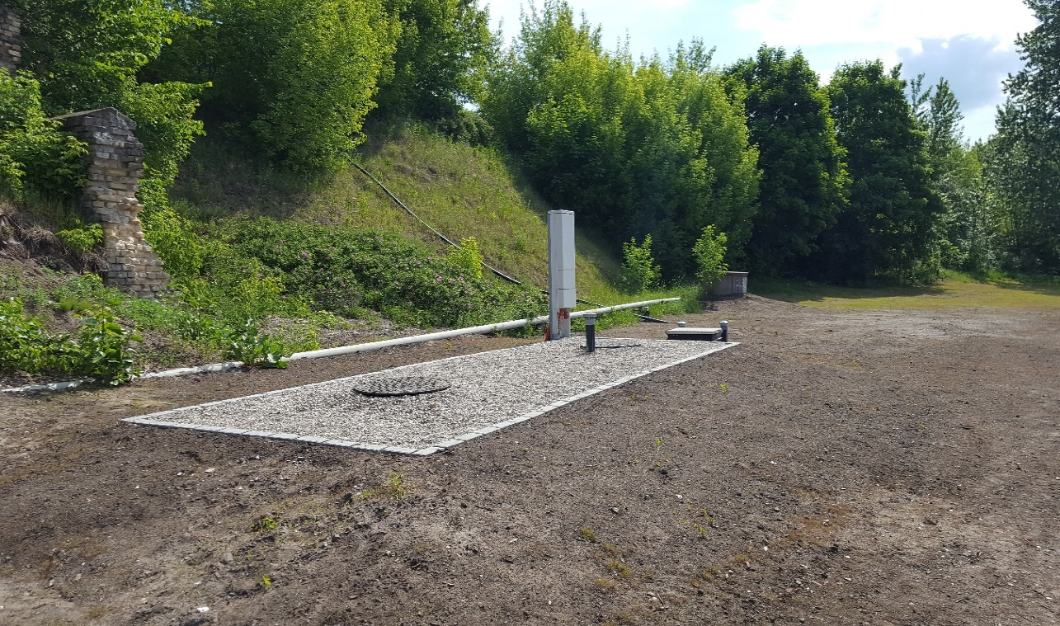
Treatment of groundwater

Slide 33
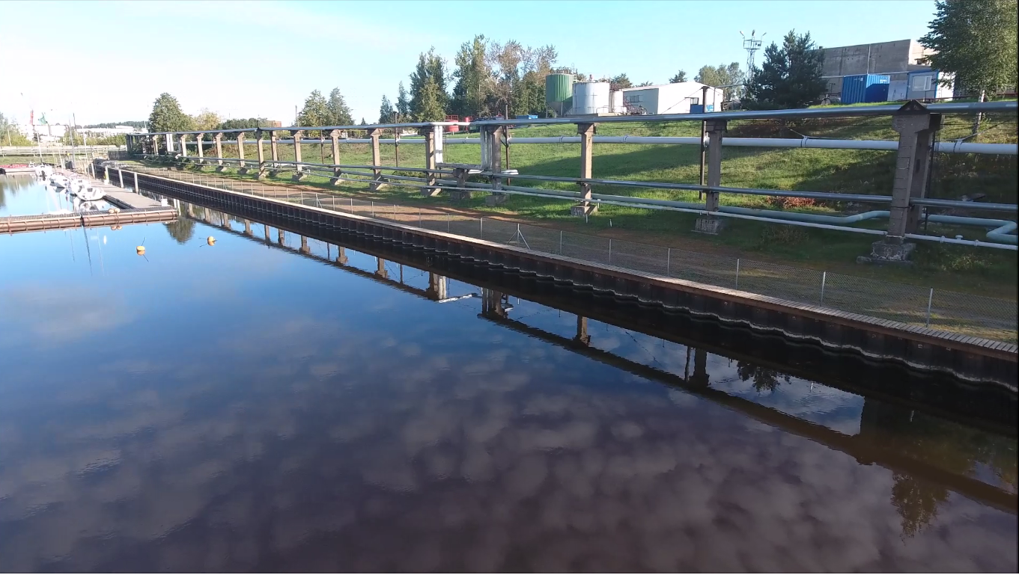
Barrier wall (376 m)

Slide 34
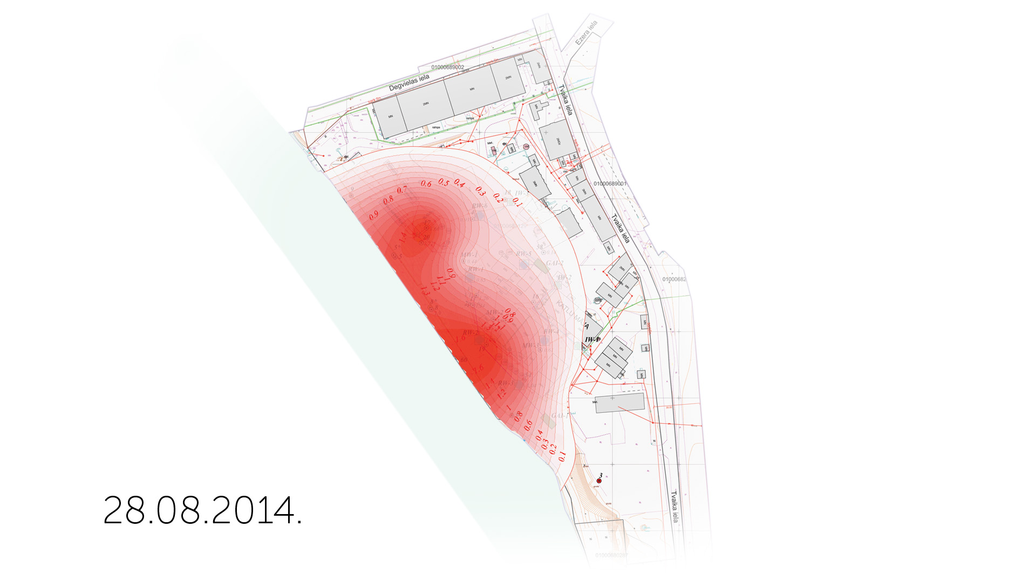
Timelapse Site III

Slide 35
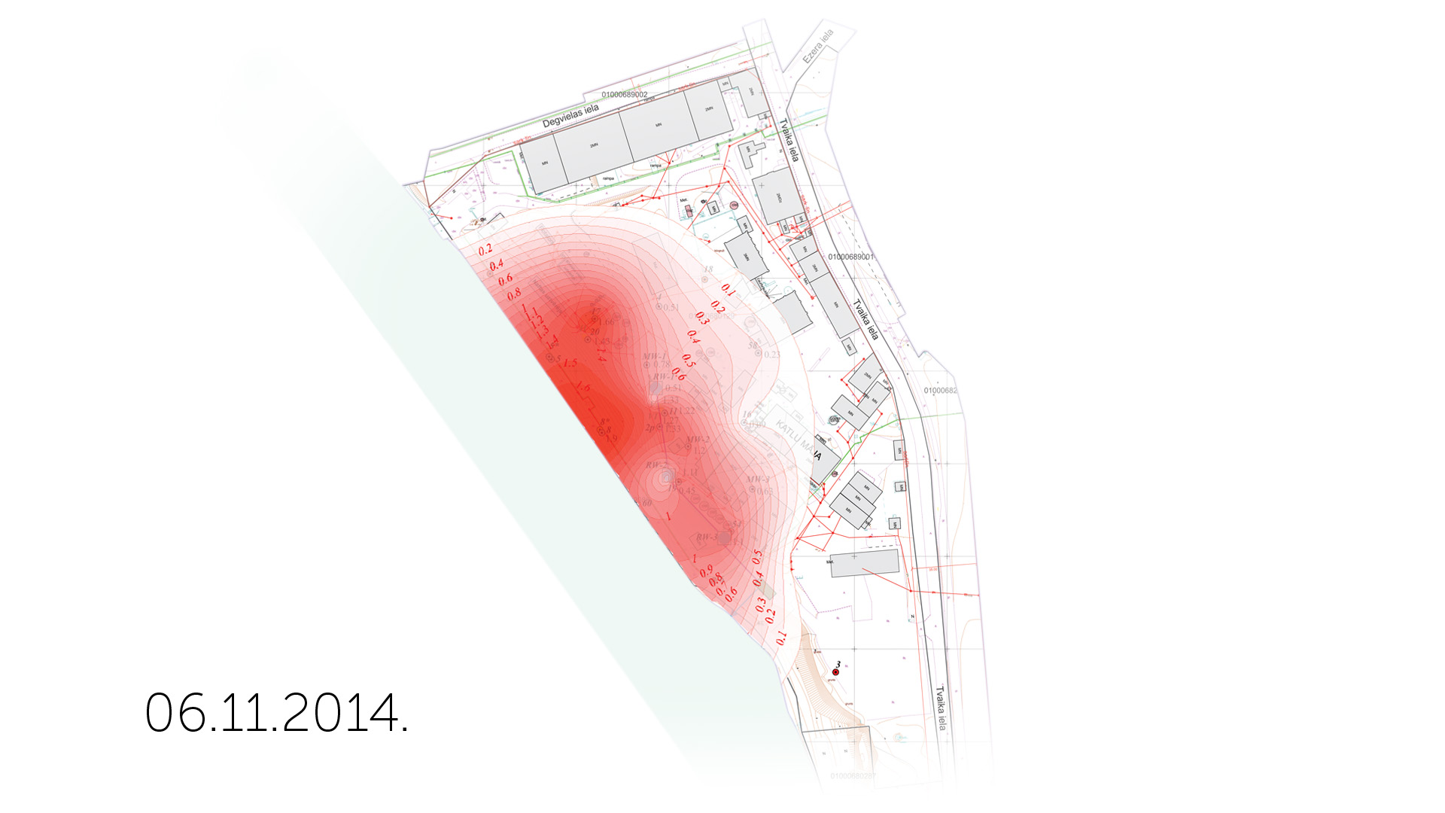

Slide 36
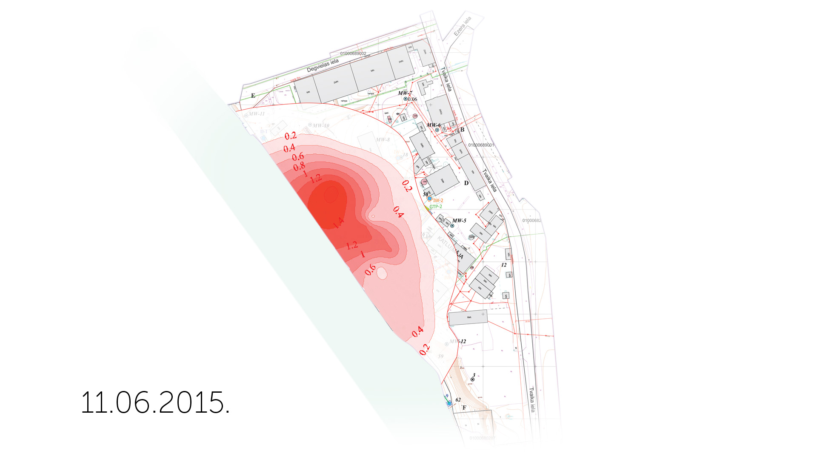

Slide 37
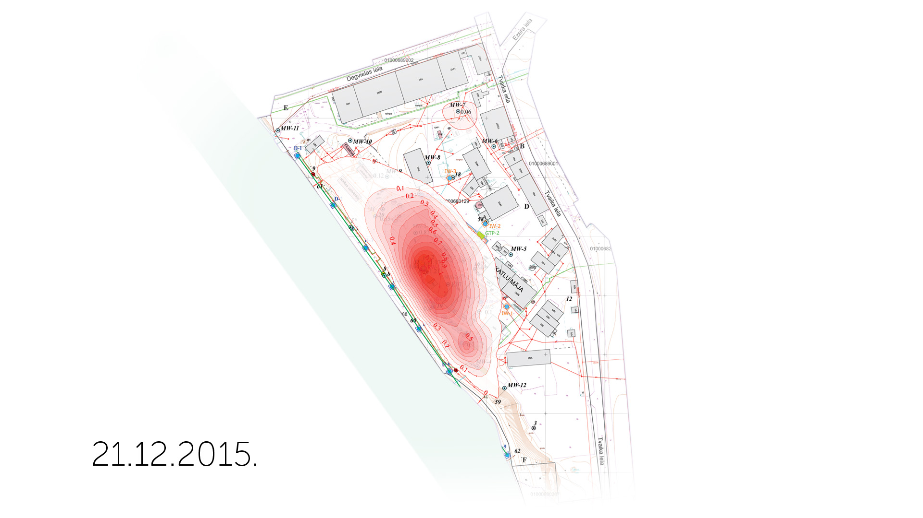

Slide 38
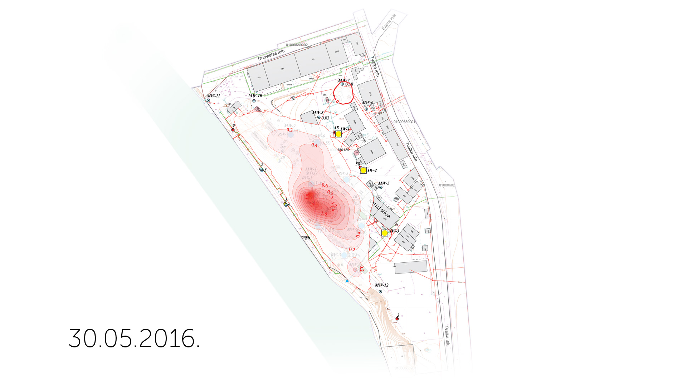

Slide 39
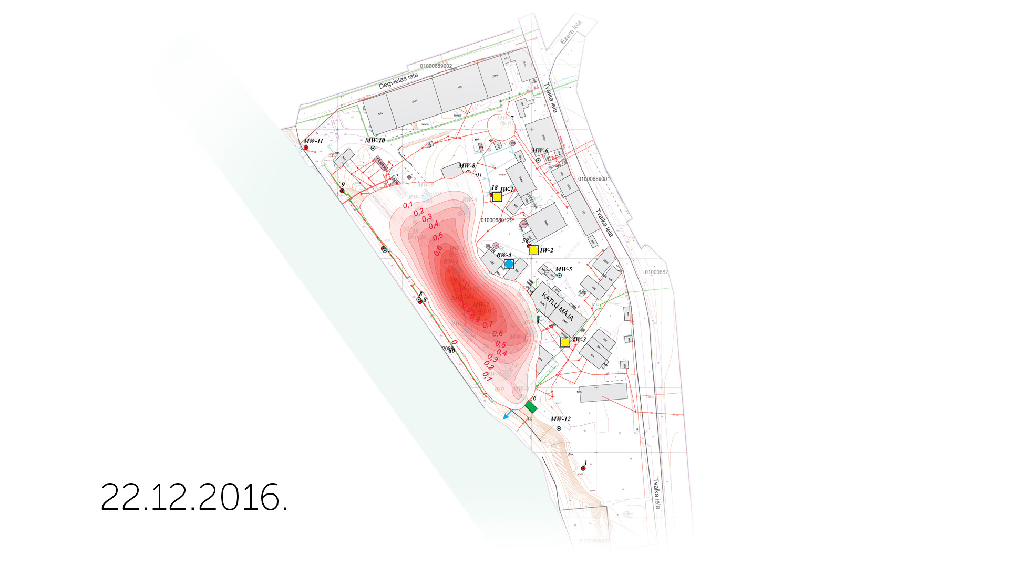

Slide 40
Results - groundwater remediation
Recovered 580 t of floating oil products;
Reached reduction level of floating oil products – 74%;
Regenerated 100`000 m3 contaminated groundwaters with mobile GTP;
Stopped oil product migration into Sarkandaugava;
Improved environmental quality in remediation territory;
Reduced risks on human health and negative influence on NATURA 2000 protection zone;
Further remediation possibilities for residue contamination and possible new oil spills.

Slide 41
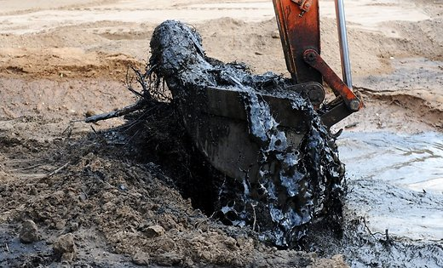
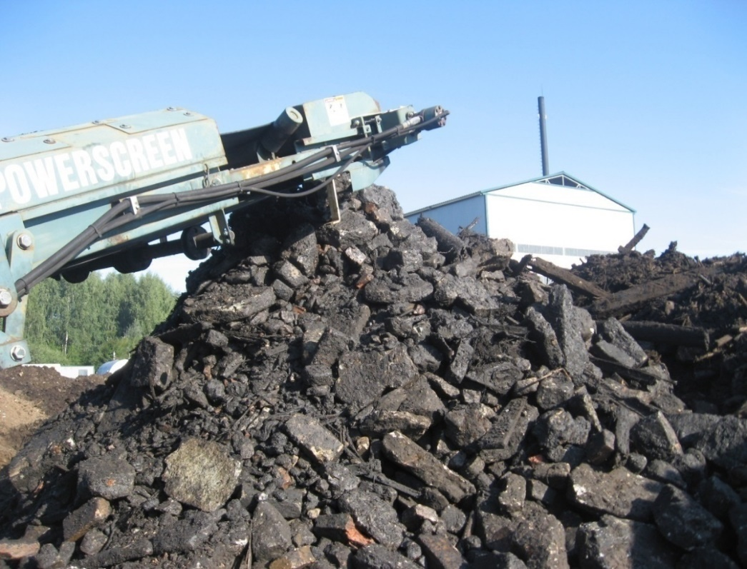
Treatment of soil
Ex situ: 5`700 t
In situ: 145 t, reduction of TPH 4-5 times.

Slide 42
Suggestions after remediation
Continious Pump&treat activities for floating oil products;
Management of drainage system;
Continious monitoring;
Management of remaining infrastructure;
Clean-up of river base material.

Slide 43
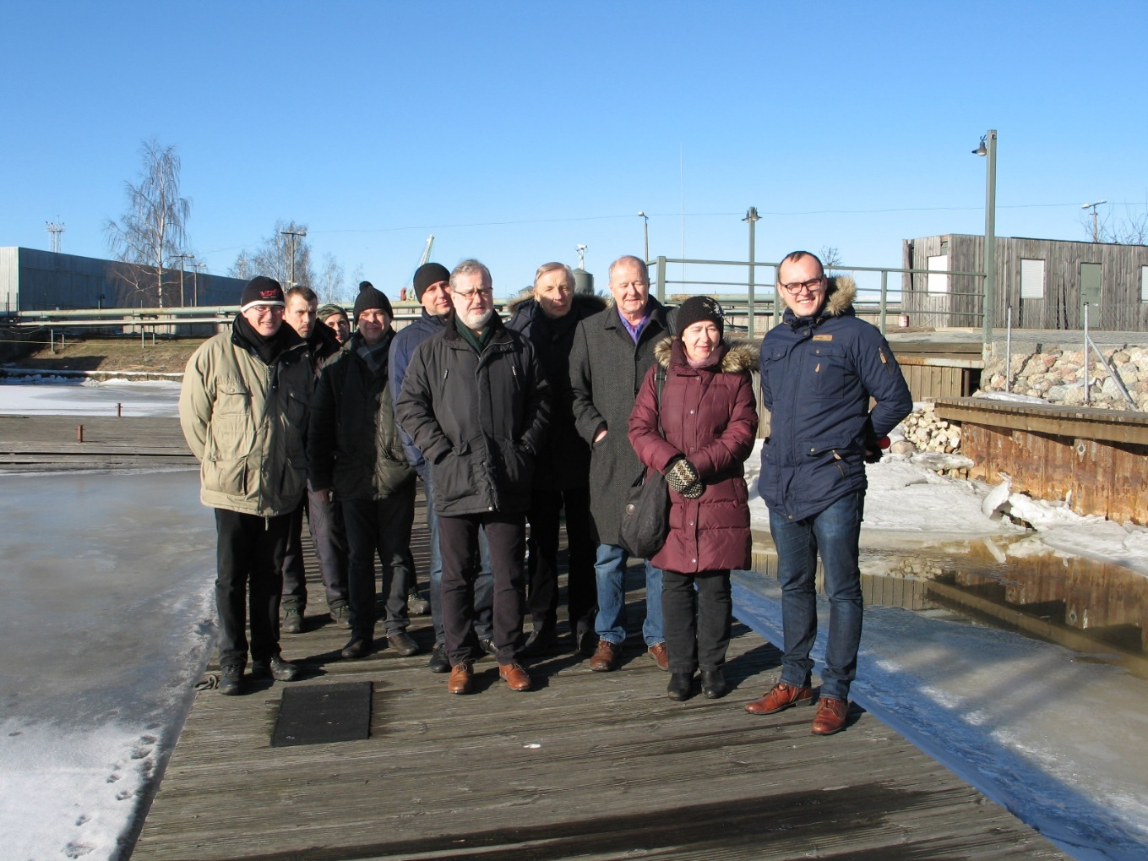
Thank you for your Attention!

