Slide 1
STATE ENVIRONMENTAL SERVICE OF THE REPUBLIC OF LATVIA
PROPOSAL ON:
POST REMEDIATION MONITORING CONCEPT
DATA MANAGEMENT
Riga – 01.06.2017

Slide 2
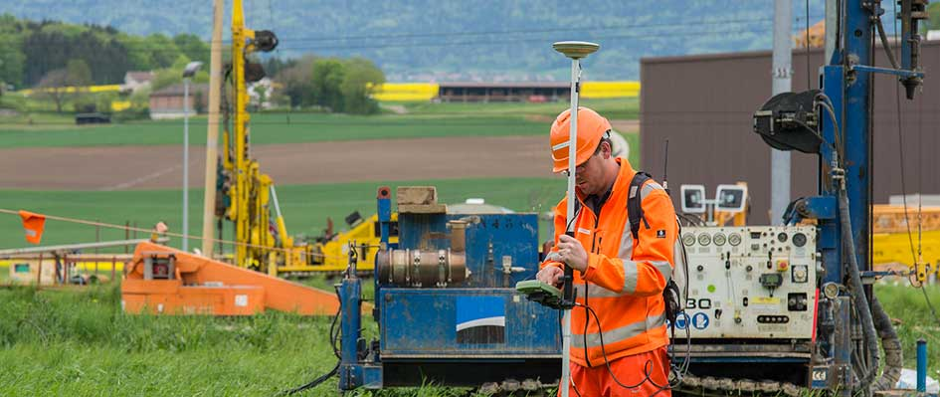
Post remediation monitoring concept
When is monitoring necessary?
  Contaminated site (to be remediated / or just to be observed)
  Partially- remediated sites
  Remediated site

Slide 3
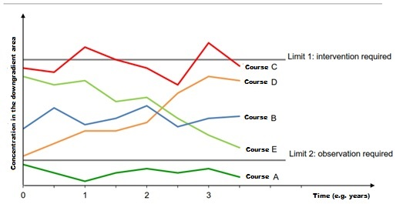
Post remediation monitoring concept
Fig. 1 Course of concentrations of different pollutants in piezometers with alarm values, etc.

Slide 4
Post remediation monitoring concept
When is monitoring necessary?
  Contaminated site (to be remediated / or just to be observed)
  Partially- remediated sites
  Remediated site

Slide 5
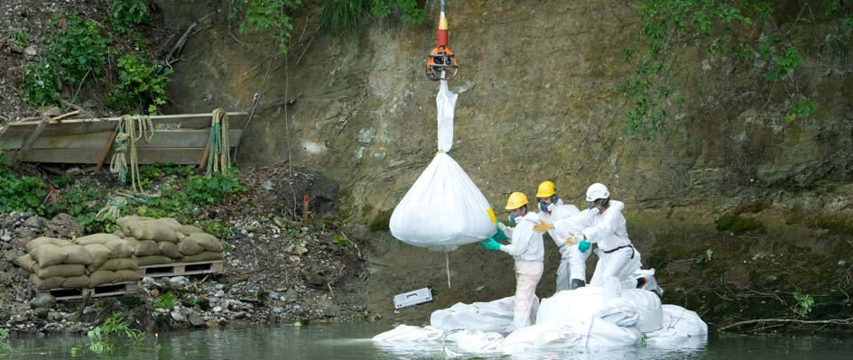
Post remediation monitoring concept
Remediation of Landfill «La Pila» - Switzerland (Elimination of «pollutant hot sposts»)

Slide 6
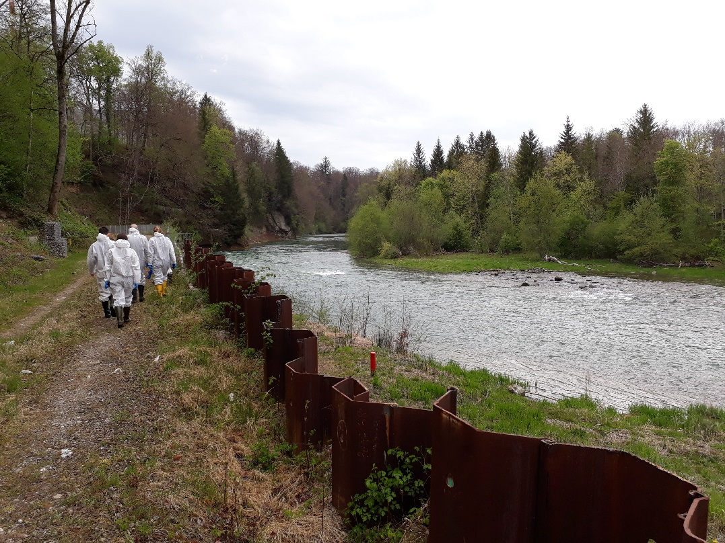
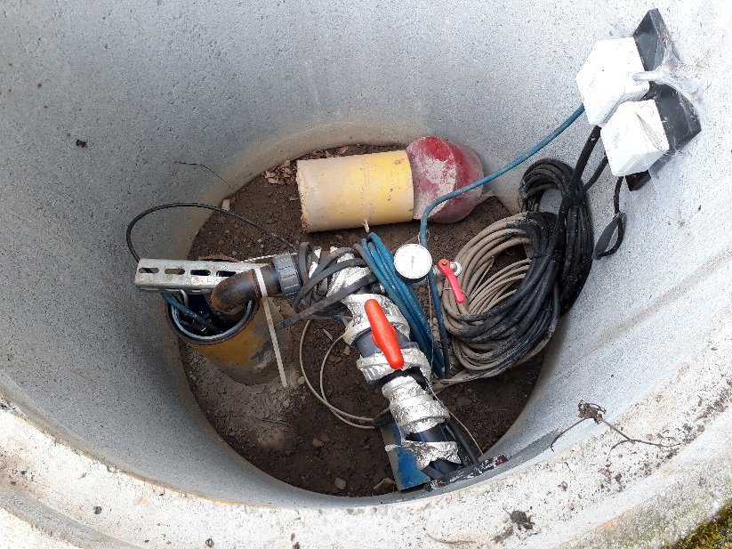
Post remediation monitoring concept
Remediation of Landfill «La Pila» - Switzerland (Elimination of «pollutant hot sposts»)

Slide 7
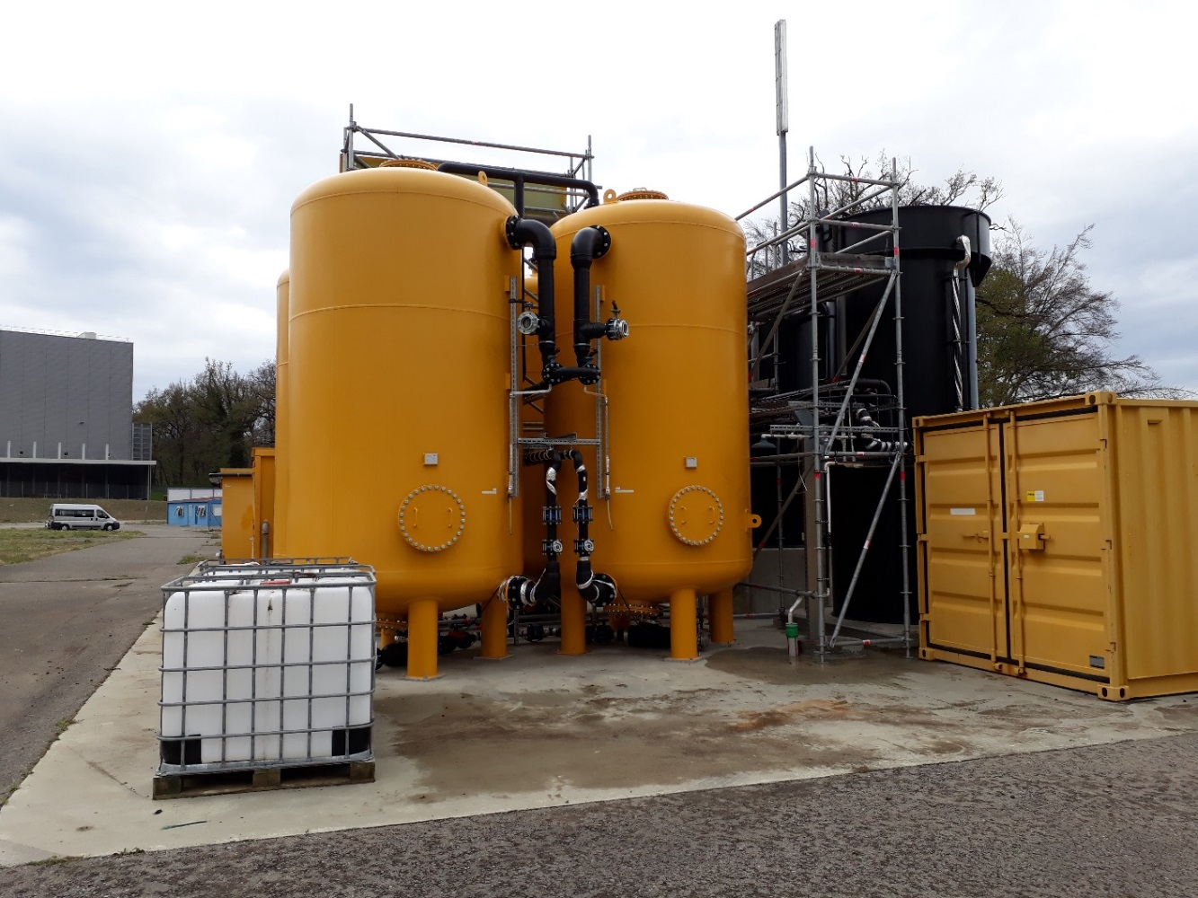
Post remediation monitoring concept
Remediation of Landfill «La Pila» - Switzerland (Chemical/physical waste water treatment)

Slide 8
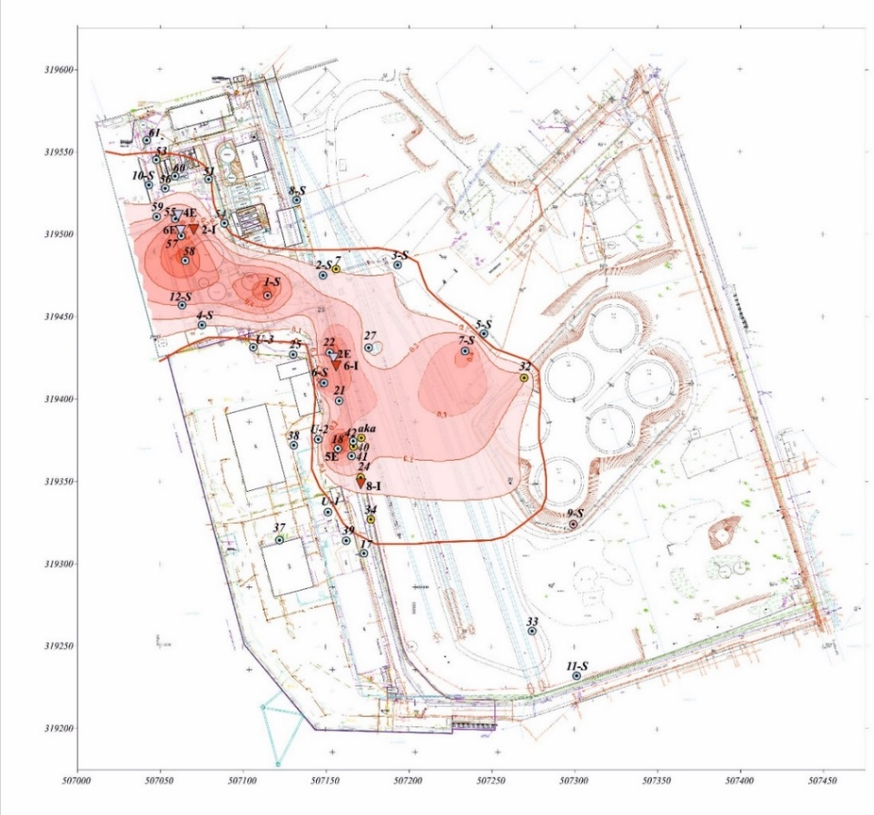
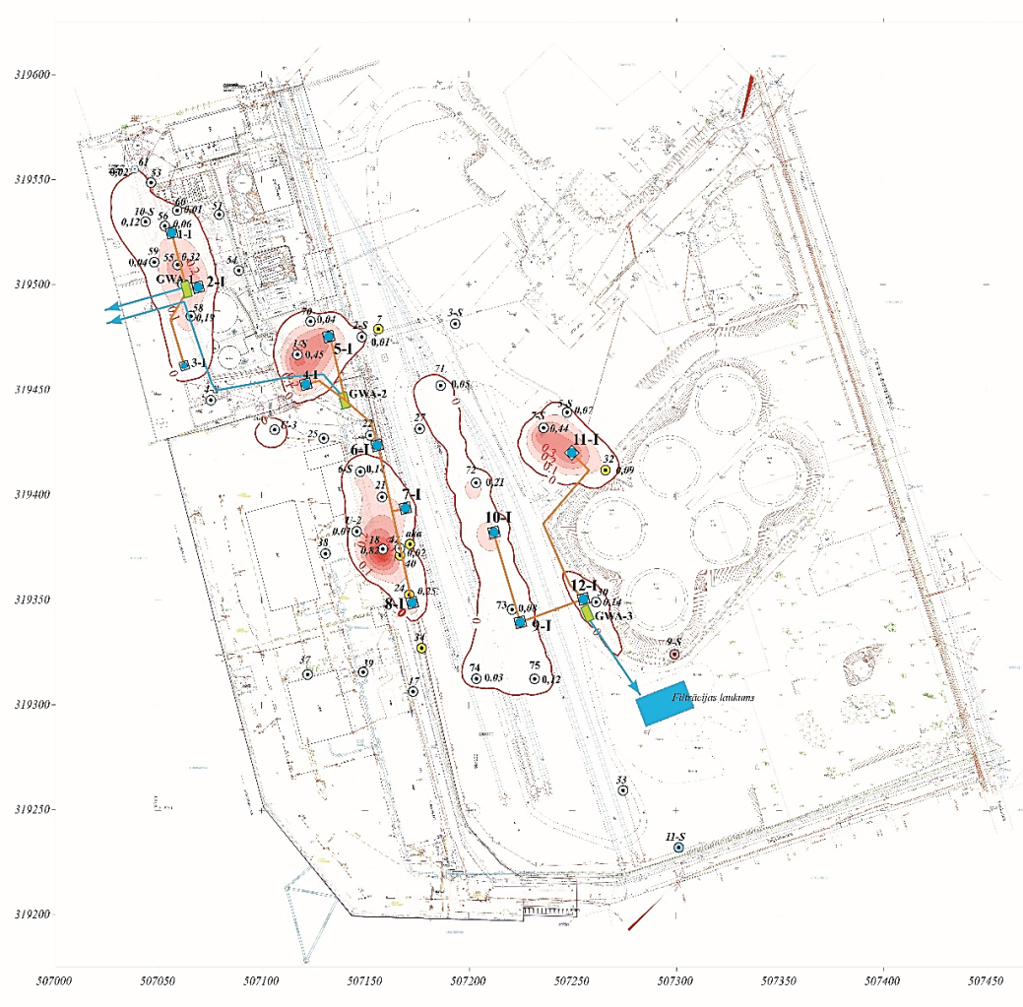
Post remediation monitoring concept
Remediation in the territory of Sarkandaugva (80-90% elimination of floating oil products)
Pictures: Intergeo/Rigarent «Final Report» (id.Nr. VVD/CS/2013/1-2/CH) -2017

Slide 9
Post remediation monitoring concept
When is monitoring necessary?
  Contaminated site (to be remediated / or just to be observed)
  Partially- remediated sites
  Remediated site (Kölliken)

Slide 10
Post remediation monitoring concept
Monitoring is a process: the «monitoring cycle»
1:“what do you want to know?”
5:“feedback; changes”
2: “how to find out”
4:“evaluation”
3: “the field and labwork”

Slide 11
Post remediation monitoring concept
The 10 basic rules for a successful monitoring program
  The objectives must be defined first and the program adapted to them and not vice versa
  The environment must be fully understood
  The appropriate methodology must be chosen
  The type of samples, sampling frequency and station location must be chosen carefully with respect of the objectives
  The field, analytical equipment and laboratory facilities must be selected in relation to the objectives and not vice versa

Slide 12
Post remediation monitoring concept
  A complete data treatment scheme must be established (data flow, storage, presentation)
  The monitoring of the environmental quality must be coupled with the appropriate environmental measurement
  The analytical quality of data must be regularly checked through internal and external controls
  The data should be given to decision makers, not merely as a list numbers, but interpreted and assessed by experts with relevant recommendations for action
  The program must be evaluated periodically, especially if the general situation or any particular influence on the environment is changed

Slide 13
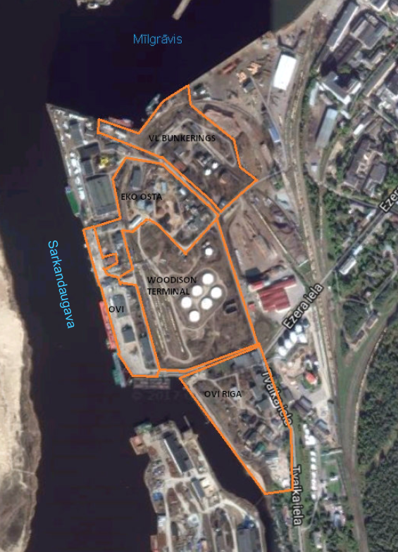
Post remediation monitoring concept
  Sarkandaugava polluted areas
  Located in the northern part of the city of Riga.
  From the western and north-western sides, they are bound by Sarkandaugava and Mīlgrāvis river arms.
Territory owned by the Riga Free Port Authority
Long term leases to several companies (“Woodison Terminal” Ltd, “Ovi Terminals” Ltd, “Eko Osta” Ltd, “VL Bunkering” Ltd and “OVI Riga” Ltd )

Slide 14
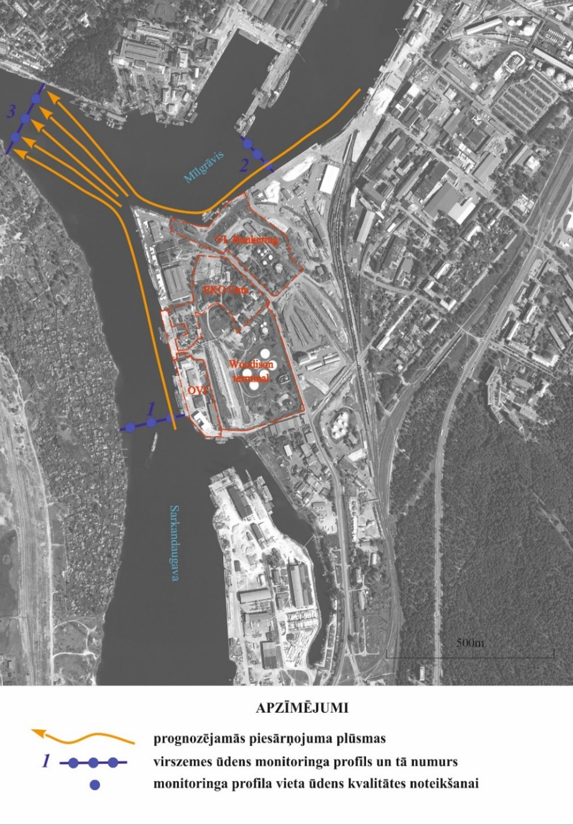
Post remediation monitoring concept
Pictures: Intergeo/Rigarent «Final Report» (id.Nr. VVD/CS/2013/1-2/CH) -2017

Slide 15
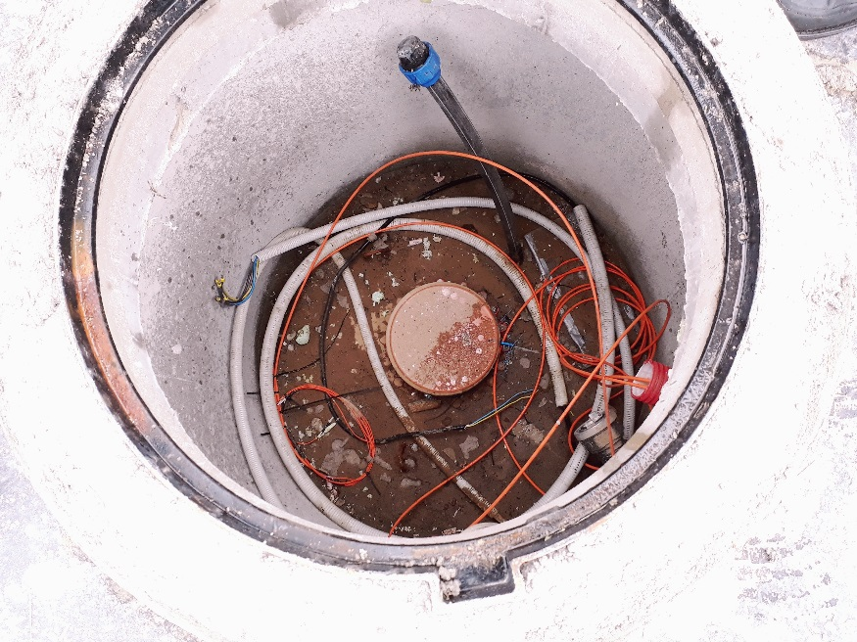
Post remediation monitoring concept
Remaining infrastructure Site I and II
  25 remediation wells;
  Underground connecting engineering networks (pressure mains, electricity, SCADA) for the operation of remediation plants);
  Infiltration field;
  Drainage system;
  Monitoring shafts;
  Power distribution with
  separated control accounting.

Slide 16
Post remediation monitoring concept
Main goals of the post remediation monitoring:
  to verify that, over the years, the quality of the environment in the Sarkandaugava polluted areas has been renewed and improved;
  to ensure that the inflow of pollution into the Sarkandaugava channel is prevented (migration of oil products from the sites has been stopped);
  to inform about needs of additional remediations
  to ensure that the soil and the ground is improved and stabilized in accordance with the Technical regulation/standards;

Slide 17
Post remediation monitoring concept
Main goals of the post remediation monitoring:
  to verify that over the years the threat to the health of inhabitants (approx. 10’000 inhabitants) has been eliminated;
  to prevent or reduce harm caused to human health, properties or the environment due to pollution by immediate reporting of accidents;
  to ensure that the health of the inhabitants of the historically polluted area in Sarkandaugava, the residents of Riga and the countries neighboring the Baltic Sea and the environmental quality of these countries will not be compromised.

Slide 18
Post remediation monitoring concept
Different types of pollution on the territory:
  viscous oil products floating above the underground waters (reduced > 80%);
  oil products remaining in the soil in the form of absorbed fractions;
  oil products remaining in ground and underground waters in the form of dissolved fractions (reduced >70%).
  Monitoring process will have to be performed over a period of 30 years.

Slide 19
Post remediation monitoring concept
  Evaluation of Environmental quality:
  According to a unified system and 3 groups of border values are set for the ground:
  A value (or target value) - Corresponding to the natural background
  B value (or precautionary border value) – Corresponding to the maximum natural concentration of contaminants exceeding of which the negative influence is acceptable for human health or the environment. Also corresponding to the level to be reached after remediation of the polluted area, in case no stricter requirements are set for remediation;
  C value (or critical border value) – Corresponding to the lower limit of strong contamination exceeding of which the functional characteristics of soil and ground are seriously hindered or the pollution endangers directly human health or environment.
  In cases when concentration pollutants reach or exceede the C value, remediation measures are required.

Slide 20
Post remediation monitoring concept
Soil quality norms
(pursuant to regulations of the Cabinet of Ministers No. 804 of 25.10.2005)

Slide 21
Post remediation monitoring concept
Water quality norms for the evaluation of underground water conditions
(pursuant to Regulations of the Cabinet of Ministers No. 118 dated 12.03.2002)

Slide 22
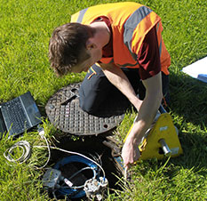
Post remediation monitoring concept
Monitoring tasks in Sarkandaugva territory
  measurement of water level and thickness of floating oil products;
  sampling and analysis of groundwater;
  sampling and analysis of the Sarkandaugava channel’s water;
  sampling and analysis of the Sarkandaugava channel’s bottom soils;
  sampling and analysis of soils;

Slide 23
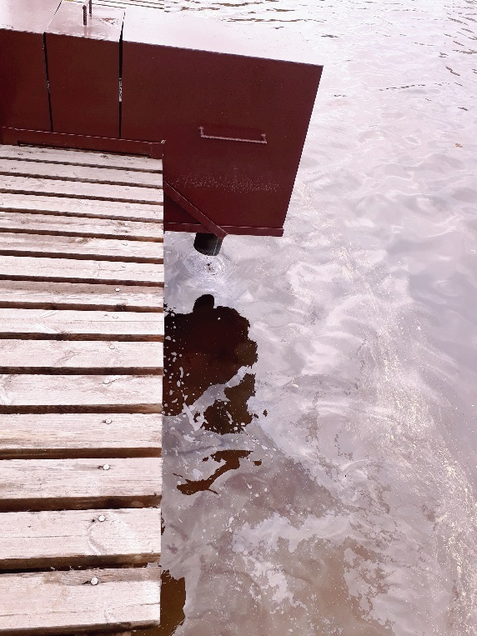
Post remediation monitoring concept
Monitoring tasks
  sampling and analysis of treated groundwater before discharge or before re-infiltration (only during the pumping operation period);
  sampling and analysis of treated groundwater from the drainage system before discharge into the river;
  drafting of a special special measurement journal;
  periodic reporting.

Slide 24
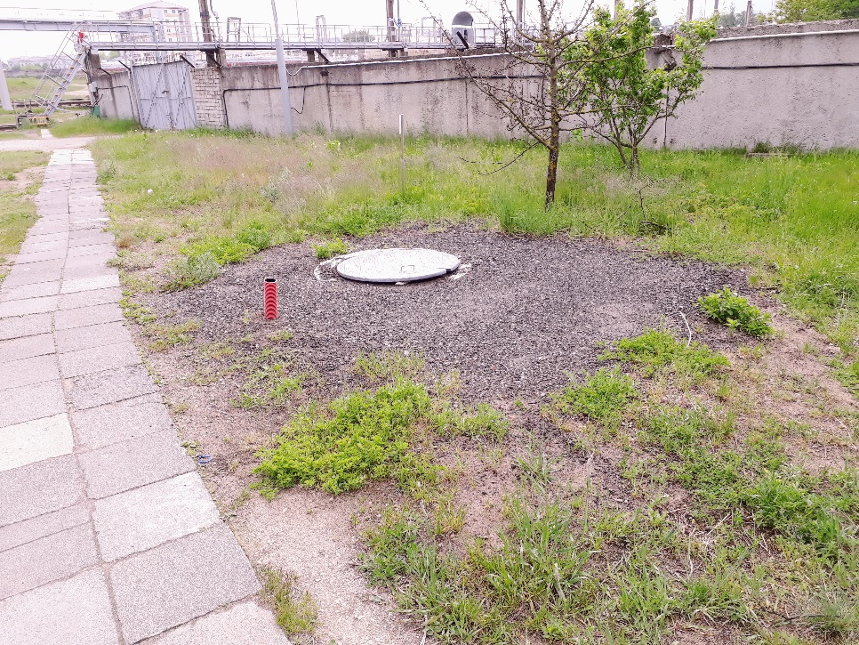
Post remediation monitoring concept
Next steps
  Choosing the parameters (taking into account new possible contaminations/accidents) to be determined
  Choosing the frequency of sampling and analysis
  Creating a baseline of data banks to start the evaluation of monitoring
  Choosing the measuring
  points
  Creating a template card to
  collect field data

Slide 25
Post remediation monitoring concept
First decade monitoring planning * (proposal)
* to verify according to the «monitoring cycle rules»
Activity | Year
 | 1 |  | 2 |  | 3 |  | 4 |  | 5 |  | 6 |  | 7 |  | 8 |  | 9 |  | 10
Measurement of water level and thickness of floating oil product | X | X | X | X | X | X | X | X | X | X | X | X | X | X | X | X | X | X | X | X
Sampling and analysis of groundwater | X |  | X |  | X |  | X |  | X |  | X |  | X |  | X |  | X |  | X
Sampling and analysis of the Sarkandaugava River’s water | X |  | X |  | X |  | X |  | X |  | X |  | X |  | X |  | X |  | X
Sampling and analysis of the Sarkandaugava River’s bottom soils | X |  | X |  |  |  |  |  | X |  |  |  |  |  |  |  |  |  | X
Sampling and analysis of soils and subsoils | X |  | X |  |  |  |  |  | X |  |  |  |  |  |  |  |  |  | X
Sampling and analysis of treated groundwater before discharge or before reinfiltration (only during the pump operation period) | X | X | X | X
Sampling and analysis of treated groundwater from the drainage system before discharge into the river | X | X | X | X | X | X | X | X | X | X | X | X | X | X | X | X | X | X | X | X
Drafting of a special measurement journal | X |  | X |  | X |  | X |  | X |  | X |  | X |  | X |  | X |  | X
Periodic reporting |  | X |  |  |  |  |  |  |  | X |  |  |  |  |  |  |  |  |  | X

Slide 26
Post remediation monitoring concept
Second decade monitoring planning * (proposal)
* to verify according to the «monitoring cycle rules»
Activity | Year
 | 11 |  | 12 |  | 13 |  | 14 |  | 15 |  | 16 |  | 17 |  | 18 |  | 19 |  | 20
Measurement of water level and thickness of floating oil product | X | X | X | X | X | X | X | X | X | X | X | X | X | X | X | X | X | X | X | X
Sampling and analysis of groundwater | X |  | X |  | X |  | X |  | X |  | X |  | X |  | X |  | X |  | X
Sampling and analysis of the Sarkandaugava River’s water | X |  | X |  | X |  | X |  | X |  | X |  | X |  | X |  | X |  | X
Sampling and analysis of the Sarkandaugava River’s bottom soils |  |  |  |  |  |  |  |  | X |  |  |  |  |  |  |  |  |  | X
Sampling and analysis of soils and subsoils |  |  |  |  |  |  |  |  | X |  |  |  |  |  |  |  |  |  | X
Sampling and analysis of treated groundwater before discharge or before reinfiltration (only during the pump operation period)
Sampling and analysis of treated groundwater from the drainage system before discharge into the river | X | X | X | X | X | X | X | X | X | X | X | X | X | X | X | X | X | X | X | X
Drafting of a special measurement journal | X |  | X |  | X |  | X |  | X |  | X |  | X |  | X |  | X |  | X
Periodic reporting |  |  |  |  |  |  |  |  |  | X |  |  |  |  |  |  |  |  |  | X

Slide 27
Post remediation monitoring concept
Third decade monitoring planning * (proposal)
* to verify according to the «monitoring cycle rules»
Activity | Year
 | 21 |  | 22 |  | 23 |  | 24 |  | 25 |  | 26 |  | 27 |  | 28 |  | 29 |  | 30
Measurement of water level and thickness of floating oil product | X | X | X | X | X | X | X | X | X | X | X | X | X | X | X | X | X | X | X | X
Sampling and analysis of groundwater | X |  | X |  | X |  | X |  | X |  | X |  | X |  | X |  | X |  | X
Sampling and analysis of the Sarkandaugava River’s water | X |  | X |  | X |  | X |  | X |  | X |  | X |  | X |  | X |  | X
Sampling and analysis of the Sarkandaugava River’s bottom soils |  |  |  |  |  |  |  |  | X |  |  |  |  |  |  |  |  |  | X
Sampling and analysis of soils and subsoils |  |  |  |  |  |  |  |  | X |  |  |  |  |  |  |  |  |  | X
Sampling and analysis of treated groundwater before discharge or before reinfiltration (only during the pump operation period)
Sampling and analysis of treated groundwater from the drainage system before discharge into the river | X | X | X | X | X | X | X | X | X | X | X | X | X | X | X | X | X | X | X | X
Drafting of a special measurement journal | X |  | X |  | X |  | X |  | X |  | X |  | X |  | X |  | X |  | X
Periodic reporting |  |  |  |  |  |  |  |  |  | X |  |  |  |  |  |  |  |  |  | X

Slide 28
Post remediation monitoring concept
Monitoring tasks in Sarkandaugva territory
  A hydro geological computer simulation will have to be done in order to determine the maximum concentration of pollutants in the groundwater, the release amount of pollutents and the dispersion of groundwater pollution area.
  Contamination concentration charts (for both water and soil) will have to be elaborated to compare data during annual monitoring.
  Oil product thickness charts will have to be elaborated to compare data during annual monitoring.

Slide 29
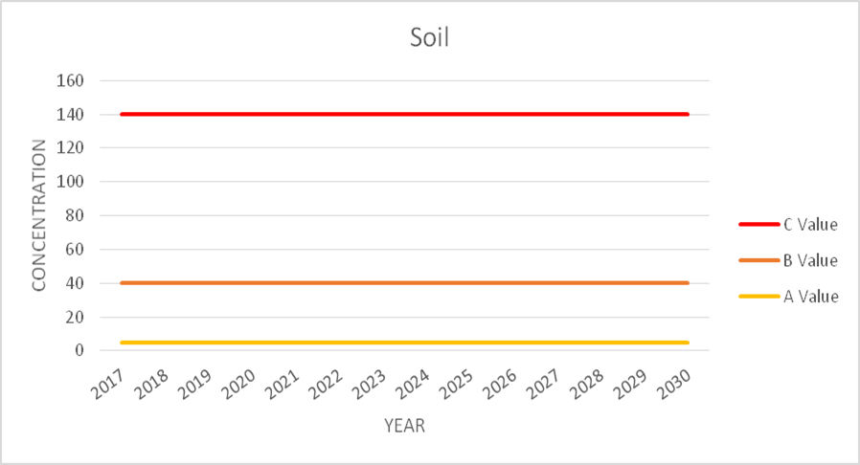
Post remediation monitoring concept
  Checking of soil contamination

Slide 30
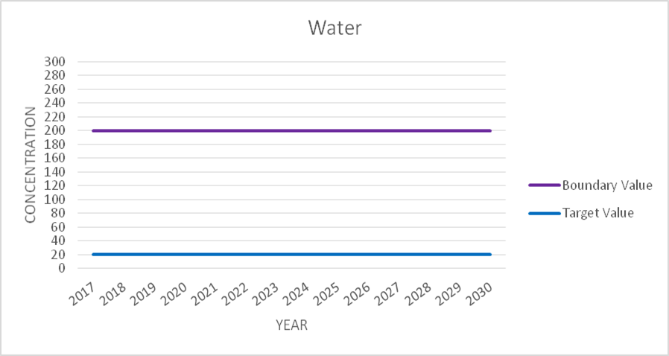
Post remediation monitoring concept
  Checking of water and groundwater contamination

Slide 31
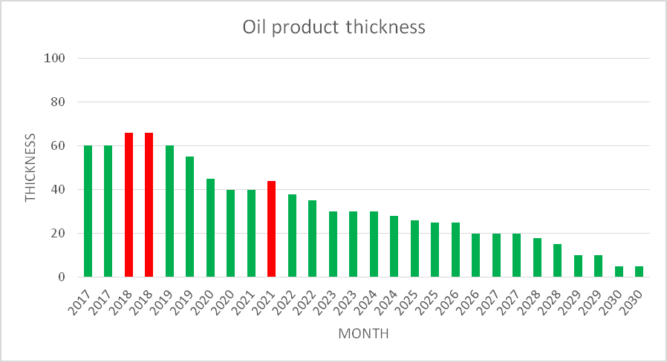
Post remediation monitoring concept
  Checking of oil product thickness
Starting pumping
Starting pumping

Slide 32
Monitoring data base
Assessment
Evaluation
SES
Consultant
Analyst
Web Browser
Viewer & Editor
Analysis
Tools
Monitoring Data Base
Ground water level
Geological Well-Profiles
Pollutant Concentration at different Levels
Interpolated Raster of Pollutant Concentration
Threshold Values
….
DB-
Administrator
Collecting/Storing
Collector
Web Browser
Import & Viewer
Laboratory
Local
authority
Web Browser Viewer
Public

Slide 33
Monitoring data base
Assessment
Public
SES,
Regional Board
Tulpe (project)
Document Management System of SES (for ABC permits)
Customer oriented structure
Adding site oriented structure referencing national register of contaminated sites
Web Browser
Viewer & Editor
DB-
Administrator
Collecting/Storing/Evaluation
Landowner /
Holder of Permission
Web Browser
Form-Editor,
File Upload & Viewer
Collector
Consultant
Laboratory

Slide 34
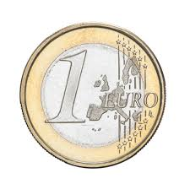
Costs Estimate
  Last but not least

Slide 35
Costs Estimate
  Examples of cost estimates in 30 years
Activity | Total Cost (€)
Measurement of water level and thickness of floating oil product | € 40.000
Sampling and analysis of groundwater | € 160.000
Sampling and analysis of the Sarkandaugava River’s water | € 30.000
Sampling and analysis of the Sarkandaugava River’s bottom soils | € 10.000
Sampling and analysis of soils and subsoils | € 140.000
Sampling and analysis of treated groundwater before discharge or before reinfiltration (only during the pump operation period) | € 10.000
Sampling and analysis of treated groundwater from the drainage system before discharge into the river | € 20.000
Drafting of a special measurement journal and other works | € 10.000
Periodic reporting | € 10.000
OVERALL TOTAL FOR 30 YEAR | € 430.0000

Slide 36


Costs Estimate

Slide 37
Costs Estimate
Treatment of disease: 97% (15 Millions)
Doctor’s check up (30 y): 3%
(0.7 cent / inhabitant * y)

Slide 38
Sarkandaugava sites – Post Monitoring Concept
Thank you for your attention
Paldies visiem

